Slide 1
COVID primer topics
Disease transmission: more on airborne, fomite and indoor vs. outdoor transmission
serologic test (antibody)
confirmed and suspected/probable cases
Infection and fatality rates, and all causes (excess) mortality
Ro: Basic reproductive number
Mitigation strategies: hand washing, hand sanitizers, social distancing, isolation and quarantine
Global variation in contact tracing: cellphones and computers (Bluedot)

Slide 2

Indoor vs. outdoor transmission
Dilution of the virus that happens outdoors
  Light wind will quickly dilute the virus
  If a person nearby is sick, the wind will scatter the virus, potentially exposing nearby people but in far smaller quantities, which are less likely to be harmful
  A few hundred to a few thousand of SARS-CoV-2 viruses to overwhelm the immune response
  As long as you’re staying at least six feet apart, the risk is very low
https://www.nytimes.com/2020/05/15/us/coronavirus-what-to-do-outside.html

Slide 3
Indirect transmission: Fomites???
The American Centre for Disease Control and Prevention (CDC) has updated their guidelines that novel coronavirus “does not spread easily” from touching surfaces or objects (Heuvelmans, 2020) https://www.nejm.org/doi/10.1056/NEJMc2004973
Our results indicate that aerosol and fomite transmission of SARS-CoV-2 is plausible, since the virus can remain viable and infectious in aerosols for hours and on surfaces up to days (depending on the inoculum shed) (van Doremalen et al., 2020)
https://www.nejm.org/doi/10.1056/NEJMc2004973

Slide 4
Confirmed and probable cases
http://www.health.gov.on.ca/en/pro/programs/publichealth/coronavirus/docs/2019_case_definition.pdf

Slide 5
Antibody (Serological) tests
Serology testing (or equivalently, serological testing) for COVID-19 may be used
  to estimate the numbers of people previously infected and potentially have immunity to the disease
https://www.nytimes.com/video/us/100000007102893/coronavirus-antibody-testing-process.html
An antibody (S309) from a patient who recovered from SARS has been shown to block COVID-19 infection in a laboratory setting
https://www.ctvnews.ca/health/coronavirus/sars-antibodies-can-block-covid-19-infection-study-1.4943895

Slide 6
Infection rates vs. actual (morbidity) rates
CFR is the ratio of the number of deaths divided by the number of confirmed (preferably by nucleic acid testing) cases of disease
  CFR globally at 0.51%
IFR is the ratio of deaths divided by the number of actual infections with SARS-CoV-2
  Because nucleic acid testing is limited and currently available primarily to people with significant indications of and risk factors for covid-19 disease, and because a large number of infections with SARS-CoV-2 result in mild or even asymptomatic disease, the IFR is likely to be significantly lower than the CFR.
  the IFR at 0.1% to 0.26%
  https://www.virology.ws/2020/04/05/infection-fatality-rate-a-critical-missing-piece-for-managing-covid-19/ (Condit, 2020)

Slide 7
conservative IFR and early estimate in the USA (Condit, 2020)
Assuming 3% of the US population (~330M) is infected with the diseaseduring the first wave, that implies 9.9M infections.
The prediction of ~93,000 deaths implies an IFR of (93000/9.9M)= 0.9%
  Close to the commonly estimated 1% CFR globally.
CFR (right now)= 115k/2.04M=0.0564*100= 5.64%
Estimated IFR(right now)=115k/9.9=0.0122*100=1%
https://www.virology.ws/2020/04/05/infection-fatality-rate-a-critical-missing-piece-for-managing-covid-19/

Slide 8
Excess deaths
Because we can’t know the exact number of deaths due to a particular disease during an epidemic, some argue it is best to look at excess death– in simple terms number of deaths in excess compared a baseline (pre-epidemic)
  The number of confirmed COVID-19 deaths may differ from the total death toll from the pandemic for several reasons:
    Some (but not all) countries only report COVID-19 deaths which occur in hospitals – people that die from the disease at home may not be recorded;
    Some countries only report deaths for which a COVID-19 test has confirmed that a patient was infected with the virus – untested individuals may not be included;
    Death reporting systems may be insufficient to accurately measure mortality – this is particularly true in resource poor countries;
    The pandemic may result in increased deaths from other causes for a number of reasons including weakened healthcare systems; fewer people seeking treatment for other health risks; less available funding and treatment for other diseases (e.g. HIV/AIDS, malaria, tuberculosis);
    The pandemic may result in fewer deaths from other causes – for example, the mobility restrictions during the pandemic might lead to fewer deaths from road accidents.
https://ourworldindata.org/excess-mortality-covid (Ritchie & Roser, Ortiz-Ospina & Hasell 2020)

Slide 9
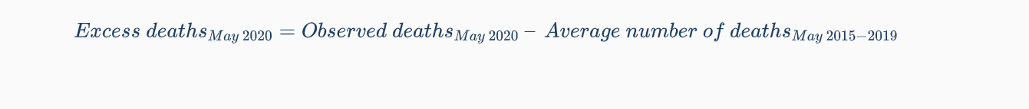
Excess deaths
One way to Calculate excess deaths requires a baseline, pre-emergency/epidemic crude mortality rate
  The difference between this baseline and the mortality rate found in the survey is then multiplied by the population size to obtain the number of excess deaths.
  OR
https://ourworldindata.org/excess-mortality-covid (Ritchie & Roser, Ortiz-Ospina & Hasell 2020)

Slide 10
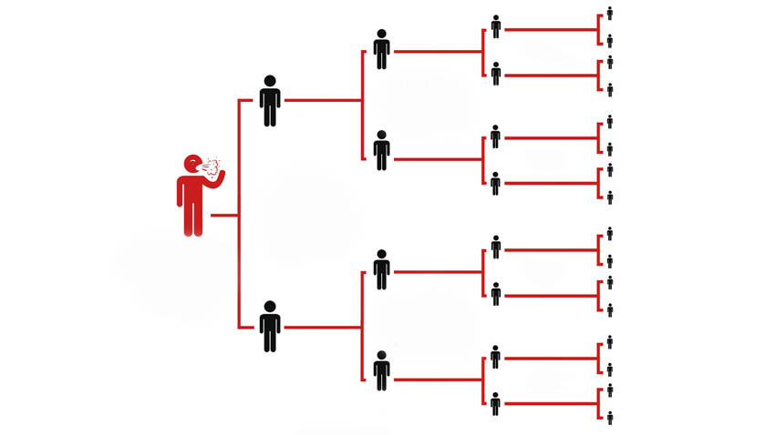
R0 (R naught): Basic reproductive number
Can be thought of as the expected number of cases directly generated by one case in a population where all individuals are susceptible to infection
R0 describes how many cases of a disease an infected person will go on to cause – in this imagined scenario R0=2. Graphic courtesy of The Conversation
https://labblog.uofmhealth.org/rounds/how-scientists-quantify-intensity-of-an-outbreak-like-covid-19 (Eisenberg, 2020)

Slide 11
Mitigation strategies
https://cdn.knightlab.com/libs/timeline3/latest/embed/index.html?source=1fkqLxJ3UKsQmmJx6h_UEOiNis3KrEDBfIVXDbMUMd2Q&font=Default&lang=en&initial_zoom=2&height=650

Slide 13

Quarantine
a state, period, or place of isolation in which people or animals that have arrived from elsewhere or been exposed to infectious or contagious disease are placed.
imposed isolation on (a person, animal, or place)

Slide 14
COVID Quarantine
        COVID quarantine in Canada: Quarantine (self-isolate) means that, for 14 days you need to:
          stay at home and monitor yourself for symptoms, even just one mild symptom
          avoid contact with other people to help prevent transmission of the virus prior to developing symptoms or at the earliest stage of illness
          do your part to prevent the spread of disease by practicing physical distancing in your home

Slide 15
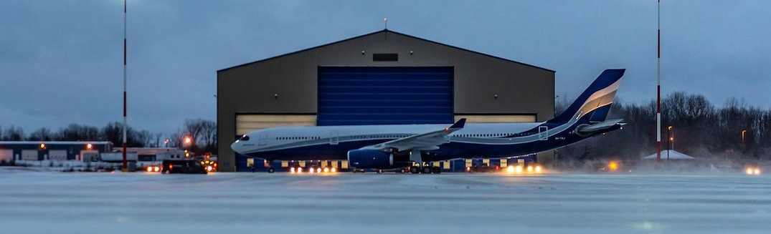
CFB Trenton: A real quarantine
Housed >200 Canadians who were airlifted from Wuhan for 14 days
Those who are being repatriated from a Japanese (Diamond Princess) cruise and were cleared to travel will be taken to CFB Trenton for further screening before they are placed under another two-week quarantine at the Nav Centre in Cornwall, ON

Slide 16
What is contact tracing?
Contact tracing is a process that is used to identify, educate and monitor individuals who have had close contact with someone who is infected with a virus. These individuals are at a higher risk of becoming infected and sharing the virus with others. Contact tracing can help the individuals understand their risk and limit further spread of the virus.
Ontario’s contact tracing resources:
https://www.publichealthontario.ca/en/diseases-and-conditions/infectious-diseases/respiratory-diseases/novel-coronavirus/contact-tracing-initiative/resources

Slide 17
Contact tracing :Blue Dot
BlueDot had spotted what would come to be known as COVID-19, nine days before the World Health Organization released its statement alerting people to the emergence of a novel coronavirus
  Founder Dr. Kamran Khan is a professor of medicine and public health at the University of Toronto
    employs diverse team of 40 people including veterinarians, doctors, epidemiologists, engineers, data scientists and software developers
  Software-as-a-service designed to track, locate and conceptualize infectious disease spread
  sends out alerts about outbreaks and the risks they may pose to health care, government, business, and public health clients
  Another goal is to understand how diseases might disperse to different parts of the world, and then determine the potential consequences of it spreading
https://www.cnbc.com/2020/03/03/bluedot-used-artificial-intelligence-to-predict-coronavirus-spread.html

Slide 18
Contact tracing :Blue Dot
correctly identify the cities that were highly connected to Wuhan using global airline ticketing data
  Predicted there would be the highest volume of travelers from Wuhan to Bangkok, Hong Kong, Tokyo, Taipei, Phuket, Seoul, and Singapore
https://www.cnbc.com/2020/03/03/bluedot-used-artificial-intelligence-to-predict-coronavirus-spread.html

Slide 19
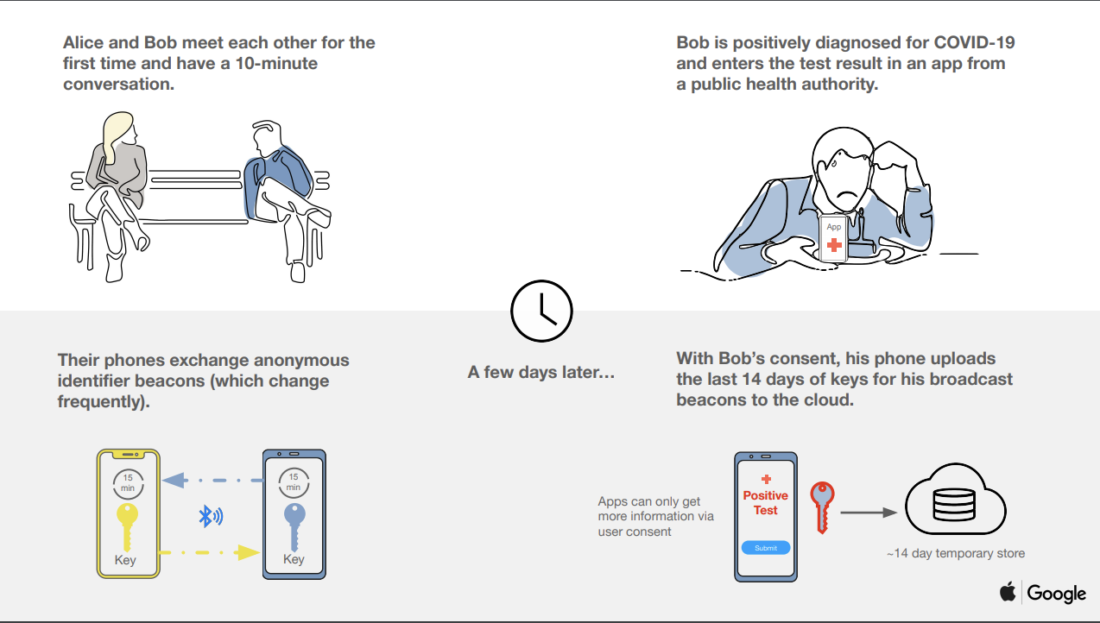
COVID contact tracing phone apps: Trace together in Singapore
https://theconversation.com/the-coronavirus-contact-tracing-app-wont-log-your-location-but-it-will-reveal-who-you-hang-out-with-136387
Notes:
20% in Sinapore cities

Slide 20
High risk populations: minorities
Not a simple correlation

Slide 22
COVID symptoms
https://infograph.venngage.com/ps/EocY0CXPDKk/covid-19-signs-and-symptoms

Slide 23
What will the future look like?
https://www.youtube.com/watch?v=K4hBCBdutUE
https://www.youtube.com/watch?v=IPu-t70bw-k

Slide 24
What will the future look like?
https://twitter.com/TIME/status/1260442641000476672?ref_src=twsrc%5Etfw%7Ctwcamp%5Etweetembed%7Ctwterm%5E1260442641000476672%7Ctwgr%5E393535353b636f6e74726f6c&ref_url=https%3A%2F%2Fanth298.opened.ca%2Fcourse-related-readings%2F
Temperature helmets
Vaccines, will it happen? Will it be necessary to eradicate the disease?

Slide 25
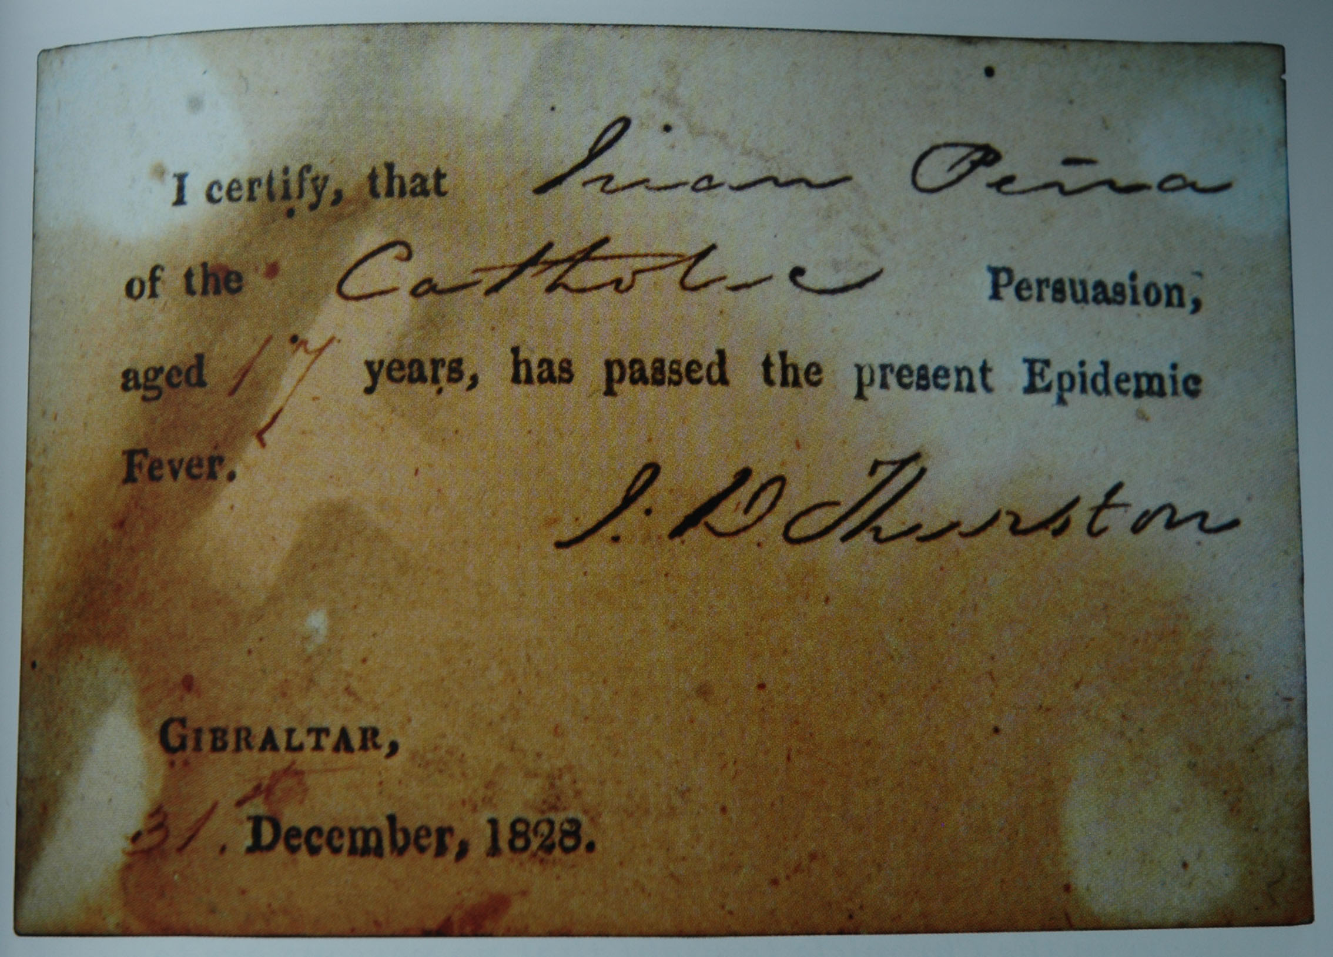
What will the future look like?
Immunity passports?

Slide 26
Health care reforms? Community health care: Government should rely less on hospitals and concentrate on making sure strong primary care is available
  Mental health and addictions service via community care
  Stronger home-care options financed through a more flexible funding model
Permanently working from home

