Slide 1
Pandemics of the past: Part II
ANTH298: Pandemics Past & Present

Slide 2
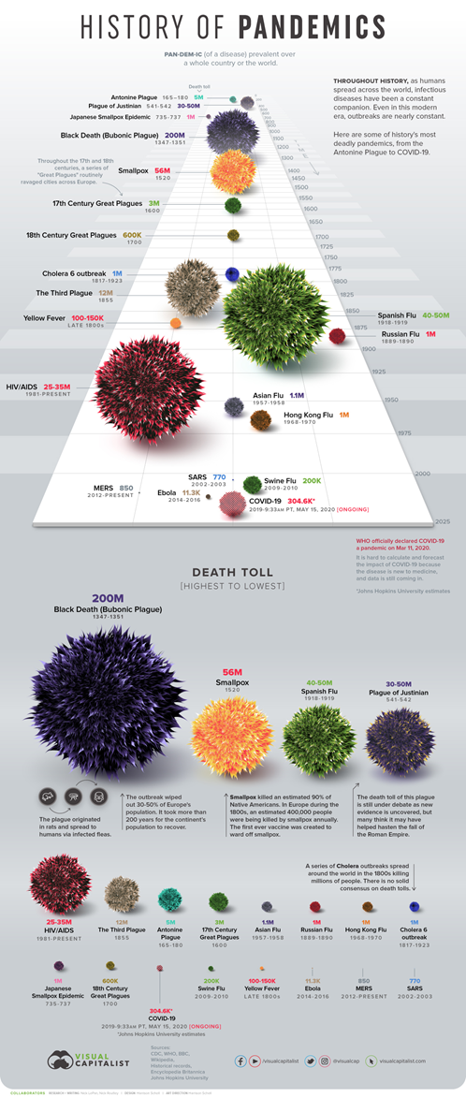

Pandemics of the past:
  Bubonic plague (second pandemic aka Black death): 1346-1353
  Cholera (6 pandemics ):1817-1923-
  Bubonic plague (the third pandemic) : 1855
  Yellow fever: late 1800s
Pandemics of the present:
  HIV/AIDS:1981-present
  SARS: 2002-2003
  Ebola:2014-2016
https://www.visualcapitalist.com/history-of-pandemics-deadliest/

Slide 3
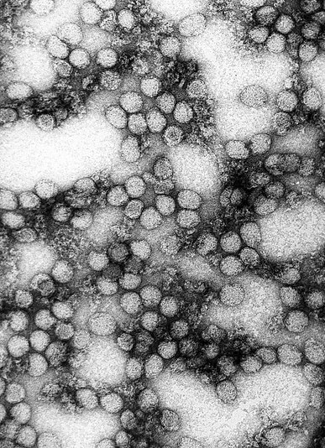
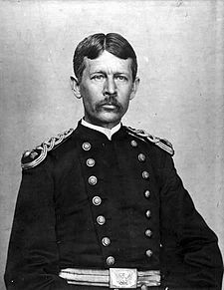
Yellow fever in the late 1800s
In 1881, Carlos Finlay of Cuba significantly advanced the field when he suggested Culex cubensis (now Aedes aegypti) as the mosquito responsible for spreading the disease (Staples & Monath, 2008)
Despite multiple attempts, he was not able to prove his theory
It was the first disease shown to be transmissible by filtered human serum and transmitted by mosquitoes (a vector), by Walter Reed around 1900
In 1927, Adrian Stokes isolated the virus from a sick man in Ghana (Staples & Monath, 2008)
Wikipedia
Notes:
Probably a pandemic much earlier, as there were epidemics in the early 1800s that were introduced from other locations. Finlay’s work served as the basis for Reed's research. Yellow fever virus originated in Africa and was brought to the western hemisphere during the slave trade era, with the first epidemic reported in 1648 in the Yucatan.

Slide 4
Yellow fever
It is an RNA virus member of the family Flaviviridae
Kills in a “spectacularly gruesome fashion,” and as such received much attention by colonial officials in colonized nations, especially among the military
  Resulted in only 100 to 500k deaths around the world, however,
  At the national level it could be devastating: see Gibraltar

Slide 5

Devasting toll
Yellow fever in 1828 in Gibraltar: most intense epidemic over 200 years in the small British colony
Notes:
Also struck in 1804, and 1818 but can’t see on this graph. Arrived from the Caribbean.

Slide 6
Symptoms
Most people are asymptomatic
Some people will develop initial symptoms:
  Sudden onset of fever
  Chills
  Severe headache
  Back pain
  General body aches
  Nausea
  Vomiting
  Fatigue (feeling tired)
  Weakness
  Most people with the initial symptoms improve within one week
  For some people who recover, weakness and fatigue might last several months
(CDC, 2019)

Slide 7
Severe symptoms of yellow fever: Also known as Black vomit
About 15% will develop a more severe form
  For 1 out of 7 people who have the initial symptoms, there will be a brief remission (a time you feel better) that may last only a few hours or for a day, followed by a more severe form of the disease.
Severe symptoms include:
  High fever
  Yellow skin (jaundice): the by product of liver damage
  Bleeding of the gums, nasal passages and stomach linings exacerbated by the liver’s inability to produce factors essential to the body’s blood clotting system
    Black vomit from nose and mouth and Bloodstained stool result of gastric bleeding and capillary damage
  Shock
  Organ failure
Case fatality rate of 30-60%
(CDC, 2019)
Notes:
Surviving provides lifelong immunity. Normally doesn’t cause permanent organ damage results

Slide 8
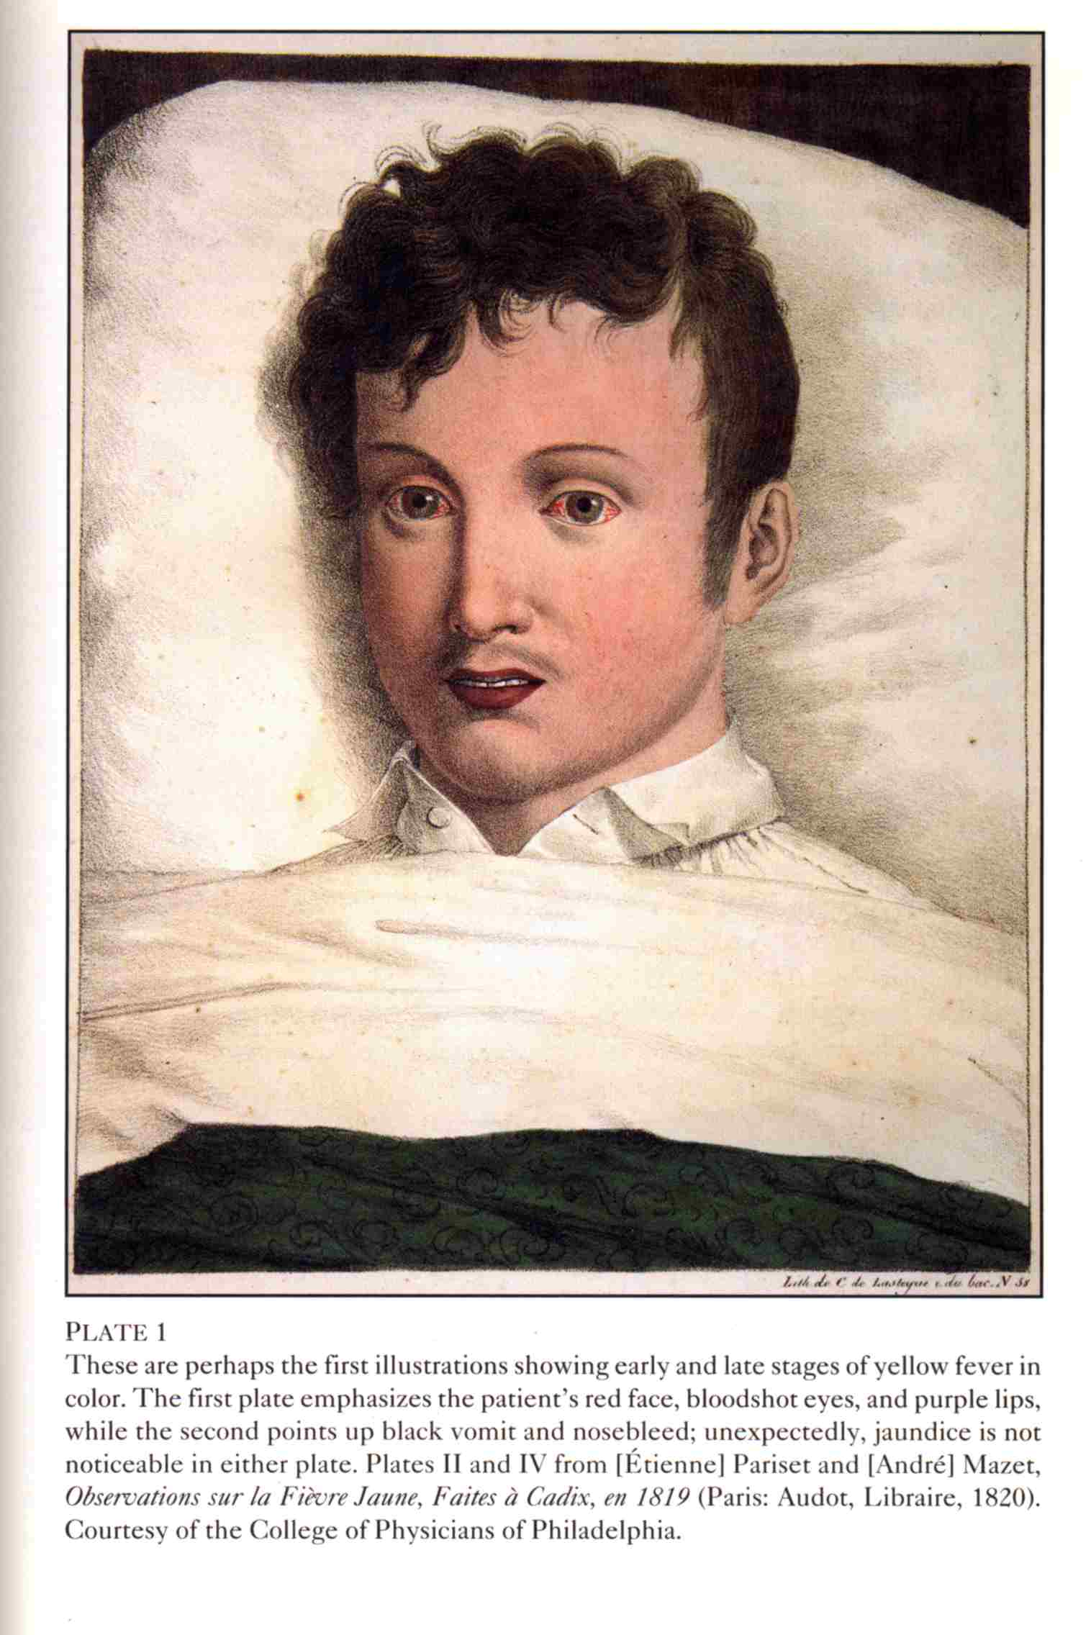
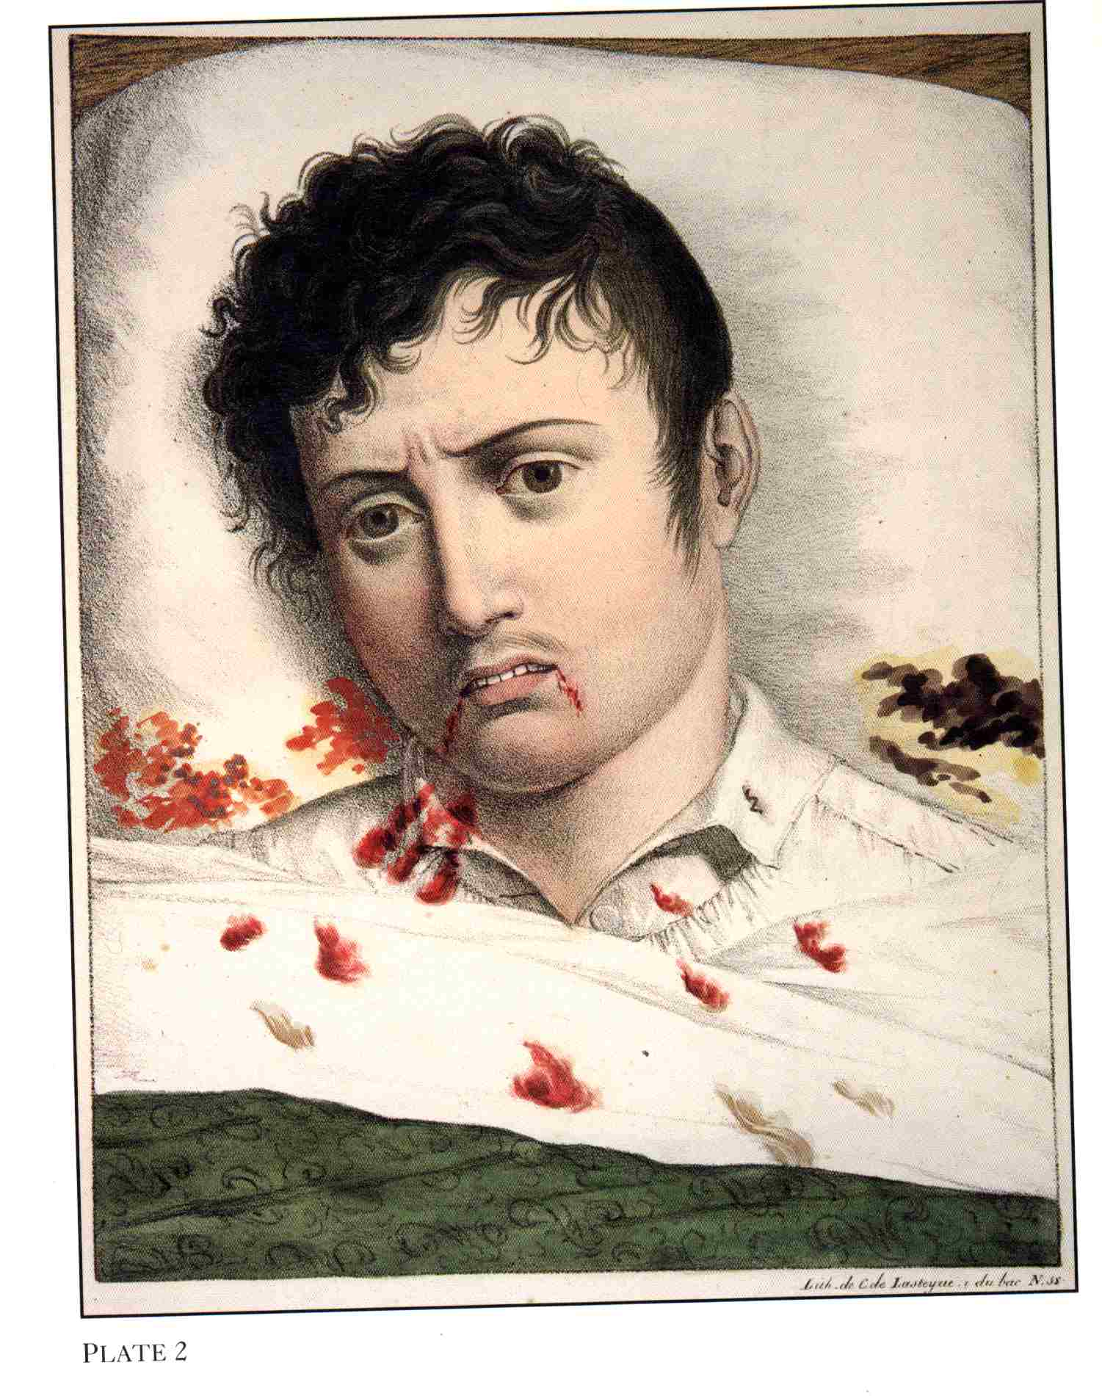
Notes:
the virus attacks the capillaries, liver and kidneys so that stomach & intestine may be full of blood

Slide 9
The Canadian case study (Cadotte & James-abra, 2015)
In 1710,yellow fever, arrived in the port of Québec from the West Indies.
  The vector mosquito Stegomya fasciata was responsible for carrying the disease on ship and infected sailors
The sick sailors were taken to Hôtel-Dieu in Québec, where they died, as well as six nurses and twelve priests
Once winter came, the mosquito and disease disappeared
No other epidemics have been reported in Canada, perhaps a few sporadic cases occurred in the country's port cities.
  On occasion, The Canadian government declared quarantine against American ports where the disease has raged.
Notes:
The epidemic must have claimed many victims, but the exact number is unknown.

Slide 10
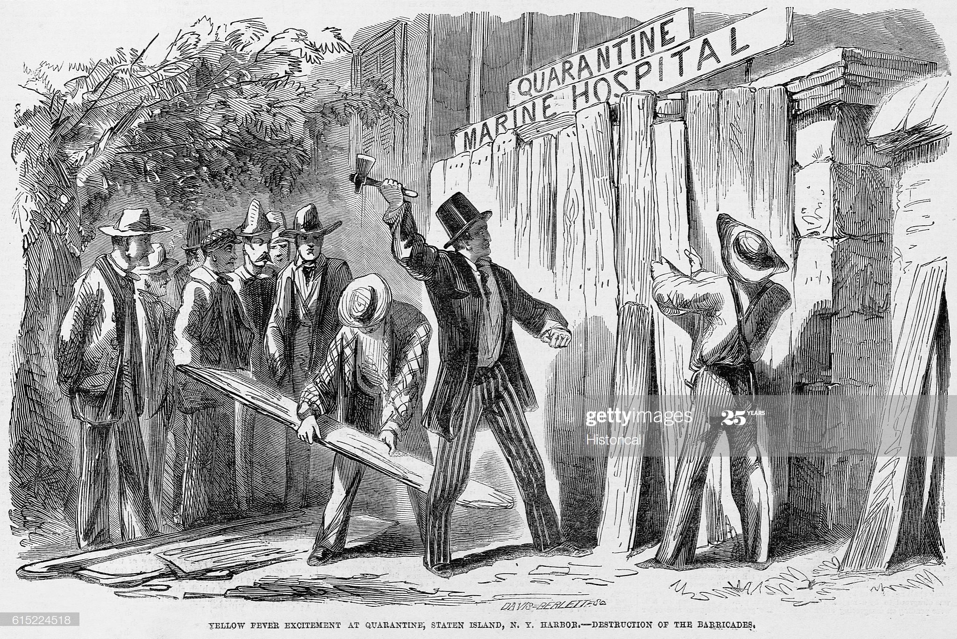
Yellow fever Eradication
Port cities tried to control entry of the disease with quarantine of ships and anti-mosquito measures
In the USA, in NYC in 1668, urban epidemics continued in the United States until 1905, with the last outbreak affecting New Orleans (Staples & Monath, 2008)
Based on Reed's work led General William Gorgas to institute a campaign in Havana against the urban mosquito vector, eliminating the disease in 1902.
  He accomplished the same task 4 years later in Panama, which allowed the canal to be completed
Yellow Fever Excitement at Quarantine, Staten Island, N.Y. Harbor, Destruction of the Barricades IllustrationAn illustration from an 1855 edition of Frank Leslie's Illustrated Newspaper. (Photo by © CORBIS/Corbis via Getty Images)
Notes:
Nearly eradicated yellow fever from South American.

Slide 11
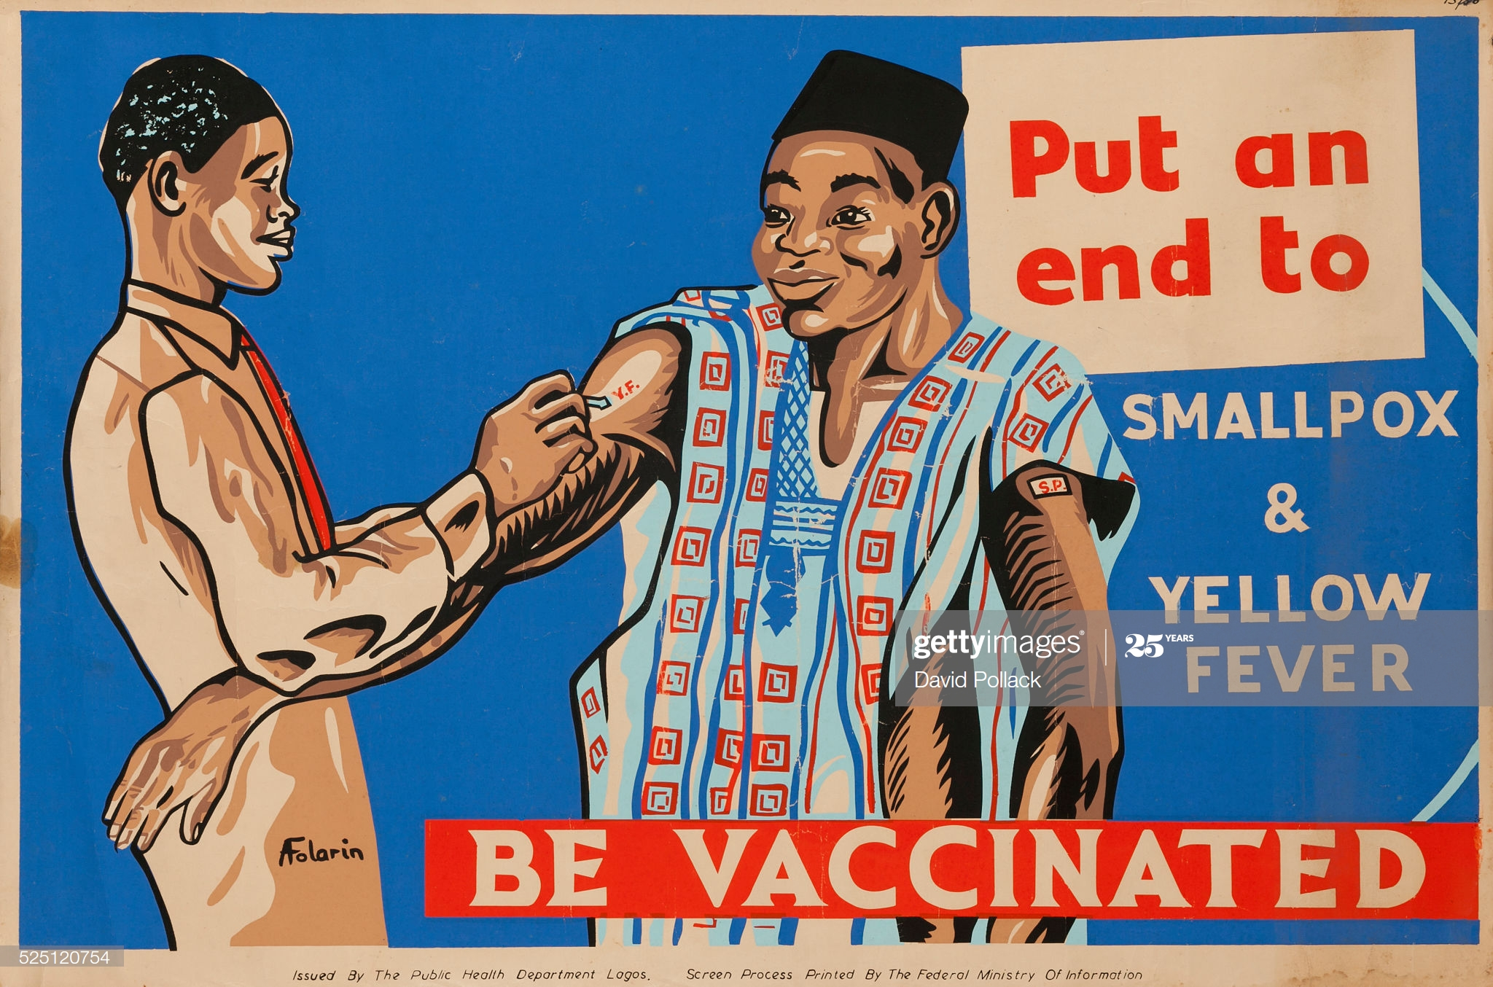

Yellow fever Eradication
By 1918, the Rockefeller Foundation formed a Yellow Fever Commission with the goal of eradicating yellow fever through the elimination of Aedes aegypti.
Early activities were initially successful against urban (Aedes aegypti–borne) yellow fever, the goal of eradication Staples & Monath, 2008)
  Later the discovered, however, that yellow fever was a zoonosis, maintained by sylvatic mosquito species and nonhuman primates in the Amazon jungle
Put an end to Smallpox and Yellow Fever, Be Vaccinated Nigeria Department of Health poster showing an African in traditional clothing being inoculated. Illustrated by A Folorin (Photo by David Pollack/Corbis via Getty Images)
Illustration on Political Caution(Original Caption) Shall We Let Him In? Mr. Mayor and gentlemen of the Board of Aldermen, the answer rests with you

Slide 12
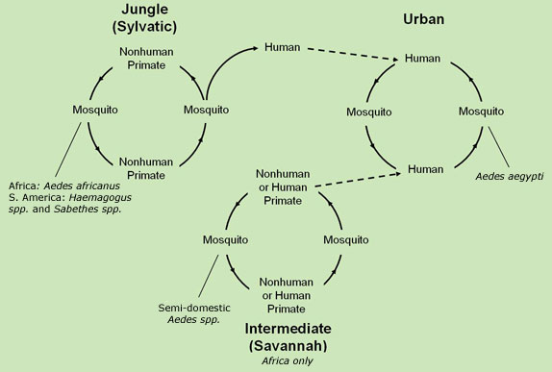
Three infectious cycles of Yellow fever
An urban form transmitted by Aedes aegypti
Jungle or sylvatic form from non-human primates
An intermediate (savannah) cycle, found in Africa:
  involves transmission of virus from mosquitoes to humans living or working in jungle border areas
https://www.cdc.gov/yellowfever/transmission/index.html
Notes:
In this cycle, the virus can be transmitted from monkey to human or from human to human via mosquitoes. The attenuated live vaccine (stem 17D) was developed in 1937 by Max Theiler. A safe and effective vaccine against yellow fever exists, and some countries require vaccinations for travelers. Other efforts to prevent infection include reducing the population of the transmitting mosquitoes. In areas where yellow fever is common, early diagnosis of cases and immunization of large parts of the population are important to prevent outbreaks.

Slide 13
Yellow fever today
Since the 1980s, the number of yellow fever cases has been increasing again, and A. aegypti has returned to the urban centers of South America (Toll, 2009)
  Partly due to limitations on available insecticides
  Habitat dislocations caused by climate change
  The vector control program was abandoned.
In Africa, virus eradication programs have mostly relied upon vaccination.
  Largely unsuccessful because they can not break the sylvatic cycle
  With few countries establishing regular vaccination programs (Toll, 2009)
Notes:
Measures to fight yellow fever have been neglected, making the future spread of the virus more likely

Slide 14
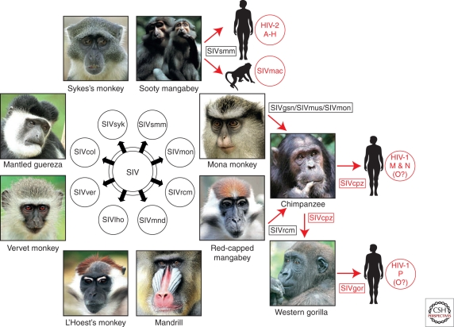
Origins of HIV (Sharp & Hanh, 2011)
Old World monkeys are naturally infected with more than 40 different lentiviruses
  simian immunodeficiency viruses (SIVs)
  Several of these SIVs have crossed the species barrier to great apes and humans, generating new pathogens (see text for details)
  In HIV-2: viral loads tend to be lower than HIV-1 infected individuals
    lower transmission rates of HIV-2 and the near complete absence of mother-to-infant transmissions
    Most individuals of the infected do not progress to AIDS
Notes:
Simian immunodeficiency viruses (SIVs) naturally infecting African primates. SIVs are given a suffix to denote their primate species of origin (e.g., SIVsmm from sooty mangabeys). SIVcpz from chimpanzees in southeastern Cameroon, gave rise to HIV-1 group M—the principal cause of the AIDS pandemic. SIVgor is pathogenic for its host, because there has been no opportunity to study the natural history of this infection in either captive or wild-living gorillas. Finally, it remains a mystery how gorillas acquired SIVgor, because they are herbivores and do not hunt or kill other mammals. Nonetheless, gorillas and chimpanzees feed in the same forest areas, which must have led to at least one encounter that allowed transmission.

Slide 15
First known death in 1959?
A man who died in the Democratic Republic of Congo is the earliest case where a blood sample can verify infection (Pickrell, 2006)
A Manchester sailor may have been infected with the disease, supposedly in December 1958 as well (Crawford, 2013)
  In the UK Royal Navy from 1955 to 1957, and was stationed in England, but he had traveled to Gibraltar and spent a day in Tangiers
  First symptoms were suggestive of TB, but treatment was ineffective, and no mycobacterium tuberculosis was detected
  Developed herpes virus and pneumonia and died in Sept 1959
  An autopsy, with a control (another body), and blinded revealed organs from the sailor tested positive for AIDS

Slide 16
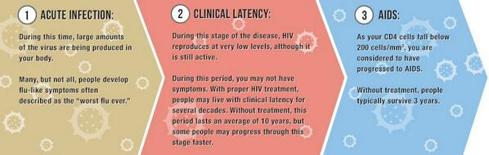
Stages of HIV (HIV.gov, 2020)
Stage 1: Acute HIV Infection
  Within 2 to 4 weeks after infection, about two-thirds of people will have a flu-like illness:
  Fever
  Chills
  Rash
  Night sweats
  Muscle aches
  Sore throat
  Fatigue
  Swollen lymph nodes
  Mouth ulcers
Stage 2: Clinical Latency (chronic infection)
  People in this stage may not feel sick or have any symptoms
  Can stay in this stage for 10 or 15 years
  Can have an undetectable viral load, if take HIV treatment every day
Can last anywhere from a few days to several weeks
Notes:
In stage 1, some people do not have any symptoms at all during this early stage of HIV.

Slide 17
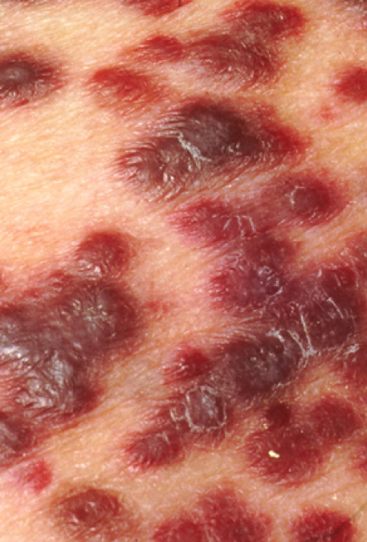
Stage 3: Acquired immunodeficiency syndrome
If not on HIV treatment → AIDS
Symptoms of AIDS can include:
  Rapid weight loss
  Recurring fever or profuse night sweats
  Extreme and unexplained tiredness
  Prolonged swelling of the lymph glands in the armpits, groin, or neck
  Diarrhea that lasts for more than a week
  Sores of the mouth, anus, or genitals
  Pneumonia
  Red, brown, pink, or purplish blotches on or under the skin or inside the mouth, nose, or eyelids
  Memory loss, depression, and other neurologic disorders
Many of these symptoms are related to opportunistic diseases because the body’s immune system is impaired (tuberculosis, certain cancers-- Kaposi’s Sarcoma, pneumonia)
(Wikipedia, 2020)
Notes:
Even if you have no symptoms, HIV infection progresses to AIDS when your CD4 T cell count dips below 200.The tumors (lesions) of Kaposi's sarcoma typically appear as painless purplish spots on the legs, feet or face. Lesions can also appear in the genital area, mouth or lymph nodes.

Slide 18
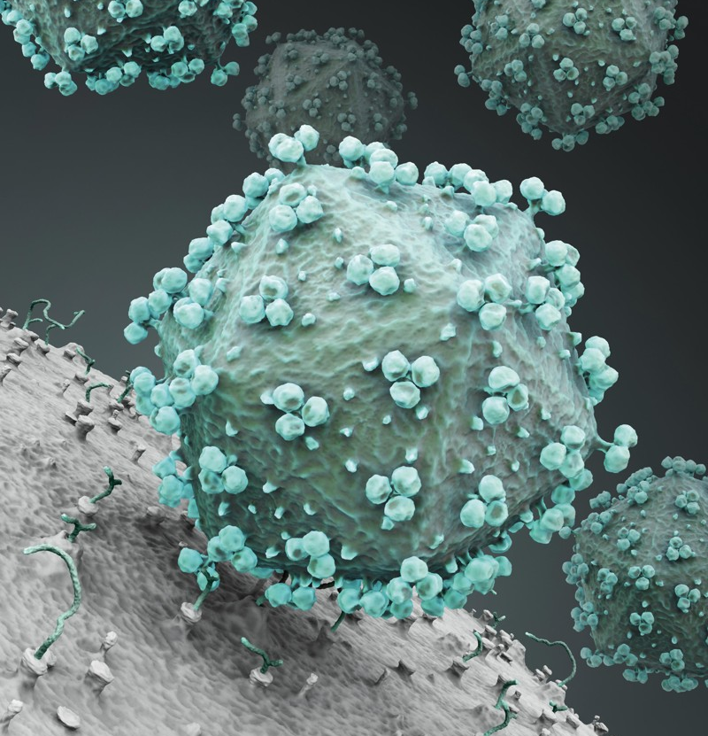
HIV/AIDS pandemic: 1981-present
The acquired immunodeficiency syndrome (AIDS) was first identified as a distinct disease in 1981 in the USA (Sharp & Hahn, 2011)
In 1983 that the virus was isolated and identified by researchers at the Pasteur Institute in France
  Originally called Lymphadenopathy-Associated Virus (or LAV)
By 1990, there were an estimated 10 million people infected with the human immunodeficiency virus (HIV).
25 million people have died of AIDS and a further 40 million have been infected with HIV making it one of the most destructive infectious disease epidemics in recorded history (Bonita, Beaglehole, & Kjellström, 2006)
Shutterstock
Notes:
First noticed in gay men. Those at risk were homosexuals, those using drugs, but also those receiving blood transfusions. In Canada, in the 1980s, we had an outbreak of HIV in people receiving contaminated blood, this mainly affected boys who had hemophilia and required blood transfusions.

Slide 19
In 2018 there were approximately 37.9 million people across the globe with HIV/AIDS (HIV.gov, 2019)
  Of these, 36.2 million were adults and 1.7 million were children (<15 years old).
  The estimate global incidence is 1.7 million
(Bonita, Beaglehole, & Kjellström, 2006)

Slide 20

HIV/AIDS today (Merson, nd)
People who are diagnosed with HIV early and start appropriate treatment can expect to have a near-normal life expectancy
  Due to innovations in therapy and improved access to health care
  Antiretroviral therapy (ART) is combination of at least three antiretroviral (ARV) drugs
For many, HIV has been transformed from an acute fatal illness to a manageable chronic condition
Since 2005, AIDS-related deaths have fallen globally by 48%; and since 2010, new HIV infections in children have fallen by 47% The epidemic continues to vary considerably between regions, however
  An estimated 1.1 million people were living with HIV in the US at the end of 2015
  In resource poor countries, such as sub-Saharan Africa, women and girls are particularly vulnerable
    Adolescent girls are contracting HIV at a disproportionate rate and AIDS is the leading cause of death amongst women of reproductive age
Notes:
In the US, one in seven did not know they were infected. ARTs began in the mid-1990s. Before, people with HIV could progress to AIDS (the last stage of HIV infection) in a few years.

Slide 21
No cure, but effective treatment and prevention
The human body can’t get rid of HIV completely, even with treatment. So once you get HIV, you have it for life (CDC, 2019)
Prophylaxis: Pre-exposure prophylaxis (or PrEP), must be taken daily to be effective
  Truvada® for PrEP is recommended to prevent HIV for all people at risk through sex or injection drug use
  Descovy® for PrEP is recommended to prevent HIV for people at risk through sex, excluding people at risk through receptive vaginal sex

Slide 22
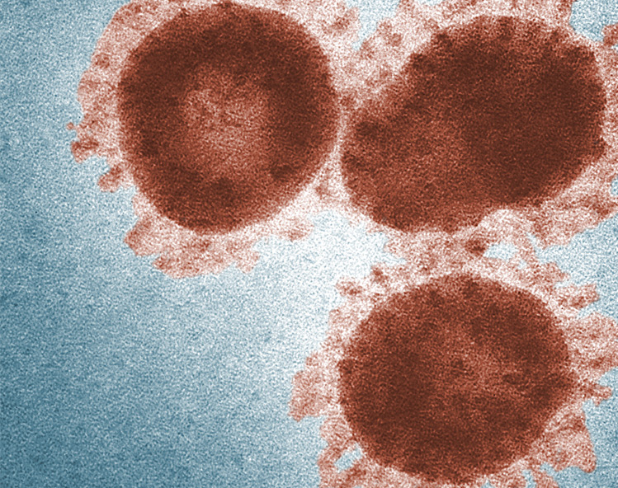
SARS: 2002-2004
SARS: Severe acute respiratory syndrome coronavirus, a virus with a crown
  A Single-stranded RNA virus which infects the epithelial cells within the lungs
In 2003 scientists, led by Marco Marra at the Michael Smith Genome Sciences Centre in Vancouver finished mapped the genetic sequence of a coronavirus using samples from infected patients in Toronto
  Collaborated with the British Columbia Centre for Disease Control and the National Microbiology Laboratory in Winnipeg, Manitoba
(CDC, 2016)

Slide 23
SARS transmission
First appeared in November 2002 in southern China with two patients with atypical pneumonia of unknown cause (Bonita, Beaglehole, & Kjellström, 2006)
  The spread to 29 countries was facilitated by air travel of infectious people
  8,096 people were infected and 774 of died (CDC, 2016)
Transmission was primarily from person-to-person (WHO, 2020)
  Occurred mainly during the second week of illness, which corresponds to (the peak of virus shedding in respiratory secretions and stool)
Most cases of human-to-human transmission occurred in the health care setting, because of close or repeated contact with infected people and in the absence of adequate infection control precautions (WHO,2020; Bonita, Beaglehole, & Kjellström, 2006)
Notes:
SARS is thought to be less easy to transmit than the current coronavirus

Slide 24
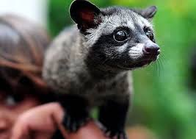
SARS origins and zoonotic transmission
The bats did not show any visible signs of disease
  they likely natural reservoirs of SARS-like coronaviruses
The University of Hong Kong and the Guangzhou Centre for Disease Control and Prevention established a genetic link between the SARS coronavirus appearing in civets and humans
  the virus had jumped across species

Slide 25
SARS in Canada
There were 251 probable cases (247 cases in Ontario, 4 cases in British Columbia), with 44 deaths in Toronto (IPAC, 2020)
  Suspected cases: 187 (128 in Ontario, 46 in B.C., 6 in Alberta, 4 in PEI, 2 in New Brunswick and 1 in Saskatchewan)
The case fatality rate was estimated at approximately 17.1% of probable cases
  Most of the fatalities occurred in patients with underlying illness, and nearly all were elderly patients with the average age being 71 years
In Ontario, Public Health officials closed two hospitals in Toronto (IPAC, 2020)
Dr. Bonnie Henry was an associate medical officer of health in Toronto in 2003 when a patient arrived at a hospital with a tuberculosis-like disease (Porter, 2020)
  Her job to figure out what was the cause of illness, and set in place plans to contain the virus
Notes:
In

Slide 26
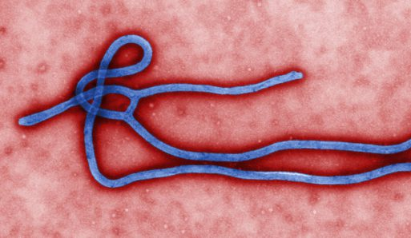
Ebola virus disease (EVD)
First appeared in 1976 in 2 simultaneous outbreaks (WHO, 2020):
  Nzara, South Sudan
  Yambuku, DRC
    in a village near the Ebola River,
The virus family Filoviridae includes three genera: Cuevavirus, Marburgvirus, and Ebolavirus
  Within the genus Ebolavirus, there are 6 species: zaire, bundibugyo, sudan, taï forest, reston and bombali
    The virus causing the current outbreak in DRC and the 2014–2016 West African(and current DRC epidemic) is the Zaire ebolavirus
CDC
Notes:
All species are named after locations. RNA Filovirus. In Zaire, in 1976, it was concluded that Belgian nuns had inadvertently started the epidemic by giving unnecessary vitamin injections to pregnant women without sterilizing the syringes and needles.

Slide 27

EVD 2014-2016 (CDC, 2019)
The index case was 18-month-old boy from a small village in Guinea was reported in December 2013
Spread to Guinea’s capital city of Conakry
Spread to neighbouring countries: Liberia and Sierra Leone.
  By July 2014, the outbreak spread to the capitals of all three countries. This was the first time more isolated, rural areas and into densely populated urban centers
  A total of 28,616 cases of EVD and 11,310 deaths.
Spread to seven more countries: Italy, Mali, Nigeria, Senegal, Spain, the United Kingdom, and the United States
  Resulted in additional36 cases and 15 deaths
Notes:
Index case is believed to be infected by fruit bats . Entering urban centres meant it provided an unprecedented opportunity for transmission. Outside of Liberia and Sierra Leone, many of the cases were in health care workers

Slide 28
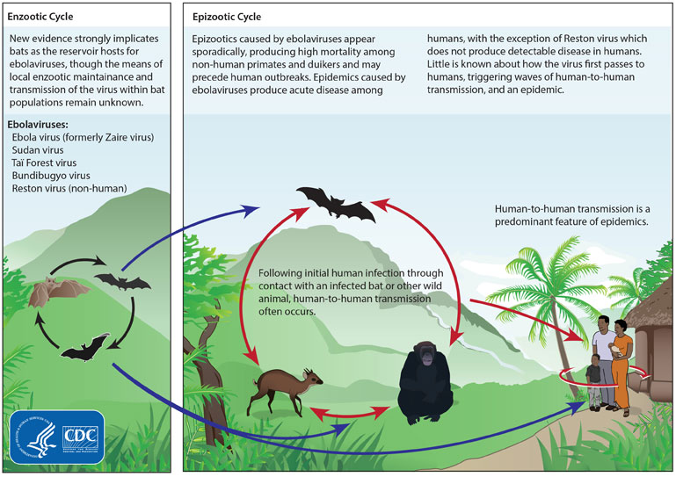
Ebolavirus transmission
The virus is not transmissible until symptoms appear (The incubation period ranges from w to 21 days -an average of 11 days)
Ebola then spreads through human-to-human transmission via direct contact (through broken skin or mucous membranes) with:
  Blood or body fluids of a person who is sick with or has died from Ebola
  Fomites that have been contaminated with body fluids (like blood, feces, vomit) from a person sick with Ebola or the body of a person who died from Ebola
The average EVD case fatality rate is around 50%. Case fatality rates have varied from 25% to 90%
Notes:
Funeral and burials. Sexual transmission is also possible. Exposure to bushmeat, but need to be careful of exoticization of eating practices (I like to see more evidence of the transmission of Ebola via this mode of transmission). Distrust of medical personnel. Beginning in 2017 and 2018, In DRC, also spread to Uganda, there was political uprising, riots that also contributed to the spread of the disease in Kivu DRC. The fundamental contributor is lack of a functioning public health and health infrastructure. In June there has been a new outbreak in the western province of Equateur, of DRC.

Slide 29
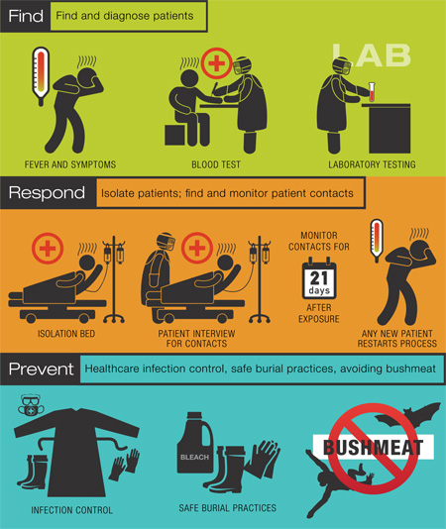
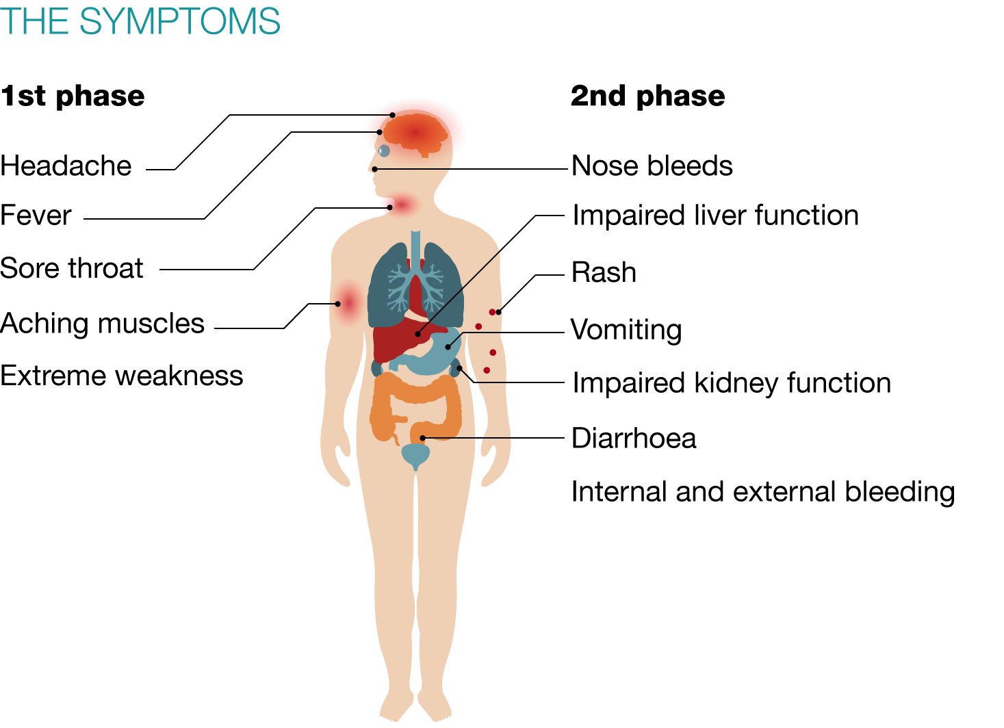

Slide 30
References
Bonita, R., Beaglehole, R., & Kjellström, T. (2006). Basic epidemiology, 2nd Ed. World Health Organization.
Cadotte, M. & James-abra, E. (2015, July 23). Epidemic in Canada: Yellow Fever. The Canadian Encyclopedia. Retrieved from https://www.history.com/news/quarantine-black-death-medieval
CDC (2019, Dec 2). About HIV/AIDS. Retrieved from https://www.cdc.gov/hiv/basics/whatishiv.html
CDC (2019, Dec 2). PrEP. Retrieved from https://www.cdc.gov/hiv/basics/prep.html
CDC (2019, Jan 15). Yellow fever. Retrieved from https://www.cdc.gov/yellowfever/symptoms/index.html
CDC (2016, Mar 3 ). SARS (10 Years After). Retrieved from https://www.cdc.gov/dotw/sars/index.html
CDC (2016, Mar 38). 2014-2016 Ebola Outbreak in West Africa. https://www.cdc.gov/vhf/ebola/history/2014-2016-outbreak/index.html
Crawford, D. H. (2013). Virus Hunt: The search for the origin of HIV/AIDs. OUP Oxford.
Merson, J. (nd). Through Science and Innovation Janssen Aims to Make HIV History. Nature Research (Advertisement feature).
IPAC (2020, June 9). SARS (Severe Acute Respiratory Syndrome). Retrieved from https://ipac-canada.org/sars.php

Slide 31
References
Pickrell, J. (2006, Sept 4). Timeline: HIV and AIDS. New Scientist. Retrieved from https://www.newscientist.com/article/dn9949-timeline-hiv-and-aids/#ixzz6P1QERCYr
Porter, C. (2020, June 5). The Top Doctor Who Aced the Coronavirus Test. New York Times. Retrieved from https://www.nytimes.com/2020/06/05/world/canada/bonnie-henry-british-columbia-coronavirus.html
Sharp, P. M., & Hahn, B. H. (2011). Origins of HIV and the AIDS pandemic. Cold Spring Harbor perspectives in medicine, 1(1), a006841.
Staples, J. E., & Monath, T. P. (2008). Yellow fever: 100 years of discovery. Jama, 300(8), 960-962.
Tolle, M. A. (2009). Mosquito-borne diseases. Current problems in pediatric and adolescent health care, 39(4), 97-140.
U.S. Department of Health & Human Services ( 2020, June 5). Symptoms of HIV. HIV.gov. Retrieved from https://www.hiv.gov/hiv-basics/overview/about-hiv-and-aids/symptoms-of-hiv
U.S. Department of Health & Human Services ( 2019, July 31). The Global HIV/AIDS Epidemic. HIV.gov. Retrieved from https://www.hiv.gov/hiv-basics/overview/data-and-trends/global-statistics
WHO (2020). SARS (Severe Acute Respiratory Syndrome). Retrieved from https://www.who.int/ith/diseases/sars/en/
WHO (2020, Feb 10). Ebola virus disease. Retrieved from https://www.who.int/news-room/fact-sheets/detail/ebola-virus-disease

