Slide 1
Pandemics of the past: part I
ANTH298: Pandemics Past & Present

Slide 2
Pandemics of the past:
Bubonic plague (second pandemic aka Black death): 1346-1353
Cholera (6 pandemics ):1817-1923-
Bubonic plague (the third pandemic) : 1855
Yellow fever: late 1800s
Pandemics of the present:
HIV/AIDS:1981-present
SARS: 2002-2003
Ebola:2014-2016
https://www.visualcapitalist.com/history-of-pandemics-deadliest/
Notes:
I used slightly different dates for the second pandemic of bubonic plague

Slide 3
The Epidemiologic transition
Originally proposed by Omran (1971) and revised in 1998
Belief that population’s health profile changes over time
It was based on social and scientific perspectives that involve changes in mortality, fertility, health care, and social environment (e.g. standards of living)
The shift in the main causes of death from infectious diseases to degenerative cardiovascular diseases and cancers

Slide 4
The Epidemiologic transition: Two constants
The assumption that the economic development of countries takes place in stages
The assumption of the epidemiologic transition as a natural destiny of societies, a path that all countries, sooner or later have to follow

Slide 5
The stages of the Epidemiologic Transition
THE AGE OF PESTILENCE & FAMINE
Life expectancy between 20 and 40 yrs., began in the early 16th century?
AGE OF RECEDING PANDEMICS
Relief from devasting epidemics that spanned across countries
Life expectancy about 30 to 50 yrs., began as early as the 17th century in some locations
AGE OF DEGENERATIVE DISEASES , STRESS, AND MAN-MADE DISEASES
Life expectancy around 70 yrs., began circa 1900
AGE OF DECLINING CARDIOVASCULAR MORTALITY, AGEING, LIFESTYLES MODIFICATION, EMERGING AND RESURGENT DISEASES
Life expectancy 80 to 85 yrs.+, occurred circa 1970
AGE OF ASPIRED QUALITY OF LIFE, WITH PARADOXICAL LONGEVITY AND PERSISTENT INEQUITIES (futuristic stage)
Life expectancy rise to 90+ (esp. females), started in the mid- 21st century
Notes:
These stages are for western societies, it has been proposed that the stages are different for non-western societies

Slide 6
The Epidemiologic Transition: Sweden
Notes:
classic

Slide 7
First Stage of the Transition
Periodic episodes of high mortality caused by outbreaks of infectious diseases like smallpox, cholera, plague malaria, typhoid, typhus, strep infections, meningitis, hep. B, Chagas’ disease, yellow fever, leprosy, neonatal tetnus, and respiratory diseases ( measles, diphtheria, poliomyelitis)
High infant mortality
Second Stage of the Transition
Reduction in the impact of many infectious disease
Children more likely to survive to childhood
Pandemics declined
Most Western societies remain in this stage for two centuries
Infectious diseases are most likely agents of selection
i.e. In 1812 typhus, and malnutrition killed more of Napoleon’s troops than due to warfare

Slide 8
Controversial framework?
Argues that non-western societies are unlikely to enter the fourth stage in a similar way as western societies, (the third sate is on of triple health burden of old, and new, and ill prepares health systems
The framework labels infectious diseases as belonging to the chronologically “behind” developing world, whereas chronic diseases are associated with modernity, prosperity, and the progressive improvement of the quality of life
framework of chronicity obscures the risks and vulnerabilities (inequalities of health)
But does recognize differentials and inequities within the transitions: age, gender, ethnic, social class, indigenous peoples, geopolitical, inter-country, and colonization

Slide 9
The evolution of infectious diseases in humans
Generally the longer the diseases become less virulent the longer they have coexisted with humans
Virulence is dependent on:
reproductive rate of the disease- faster→ more virulent
Production of toxins → mor virulent
Mode of transmission:
Direct (contact, airborne or sexual) → more benign because must make contact with other susceptible; unlikely to transfer disease if very ill (e.g. rhinovirus, sexually transmitted diseases like gonorrhea or chalmydia, and HIV)
Indirect (airborne, common vehicles, fomites, vectors, some injections) → potentially more virulent (e.g. malaria, cholera in water system)
Notes:
Cholera can produce toxins to varying degree. More virulent and production of toxins comes at a cost and is more expensive. There has to be an advantage to a more virulent strategy allows for spread to more susceptible hosts more quickly, thereby having higher fitness. For direct transmission, the chances of transmission to a new host are low if the infected person is not up and around and interacting with other susceptible individuals. It is most likely that the infectious agent will be destroyed by the immune system before it can get to another host (fitness is severely limited). HIV has an extended period of time before manifestation of symptoms.

Slide 10
Natural selection and diseases
If there is a genetic component for susceptibility/resistance to diseases and a bearing on reproductive success through fitness (a gene that will impact on ability to survive and reproduce), there can be selection for or against certain genes in the population (e.g. blood type)
The influence of the variant genes (either aiding/deterring survival) must exert before the post-reproductive period
So, for e.g., late-onset diseases (post-reproductive) will have no selective effect

Slide 11
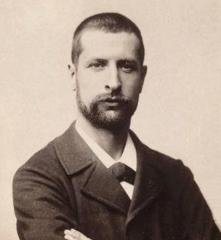
Andre Yersin
https://en.wikipedia.org/wiki/Alexandre_Yersin
Swiss bacteriologist in Paris
Sent by Institute Pasteur to the far East to study plague
First isolated the plague bacillus in 1894
perhaps also discovered by Kitasato Shibasaburō around the same time; briefly named Kitasato-Yersin bacillus
Plague bacillus is named after him (Yersinia pestis), though he originally named it after his teacher Pasteurella pestis
Notes:
Kitasato discovered a streptococcus not found in the lymphatic glands

Slide 12
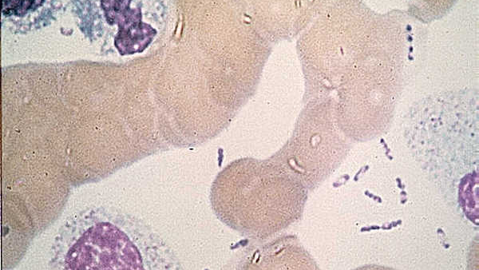
The Bacterium
Yersinia pestis: a bacillus
Survival:
In soil = briefly
In soft tissue = about 1 week
Frozen = for years
Appearance
“Safety Pin” appearance in stained slide preparations

Slide 13
The three types of plague
Bubonic Plague
Primary site of involvement = lymph nodes
Septicemic Plague
Bacillus traveling through the bloodstream, bleeding into the skin and other organs
Pneumonic Plague
Primary site of involvement = the lungs, can be caused by airborne transmission

Slide 14
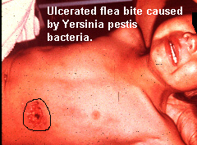
Bubonic plague
Fever, headache, chills, and weakness
One or more swollen, tender and painful lymph nodes (called buboes)
Transmission:
Usually indirect, vector-borne from infected flea bite
Bacteria multiply in the lymph node closest to where the bacteria entered the human body
If not treated with appropriate antibiotics, the bacteria can spread to other parts of the body (e.g. bloodstream & lungs)

Slide 15
Justinian pandemic Northern Africa (originated in Ethiopia), Middle East and Europe
Third pandemic originated in China, 15 million killed, mainly in India
541-750 AD
1346–1840
1894-1959
1960- present day
Second pandemic
Discovery of bacillus in 1894
Introduction of antibiotics to treat the plague 1930s-1940s
Outbreaks of plague; it is endemic in some countries
The Black death from 1346-53, considered to be worse pandemic ever – “The mother of all pandemics”

Slide 16
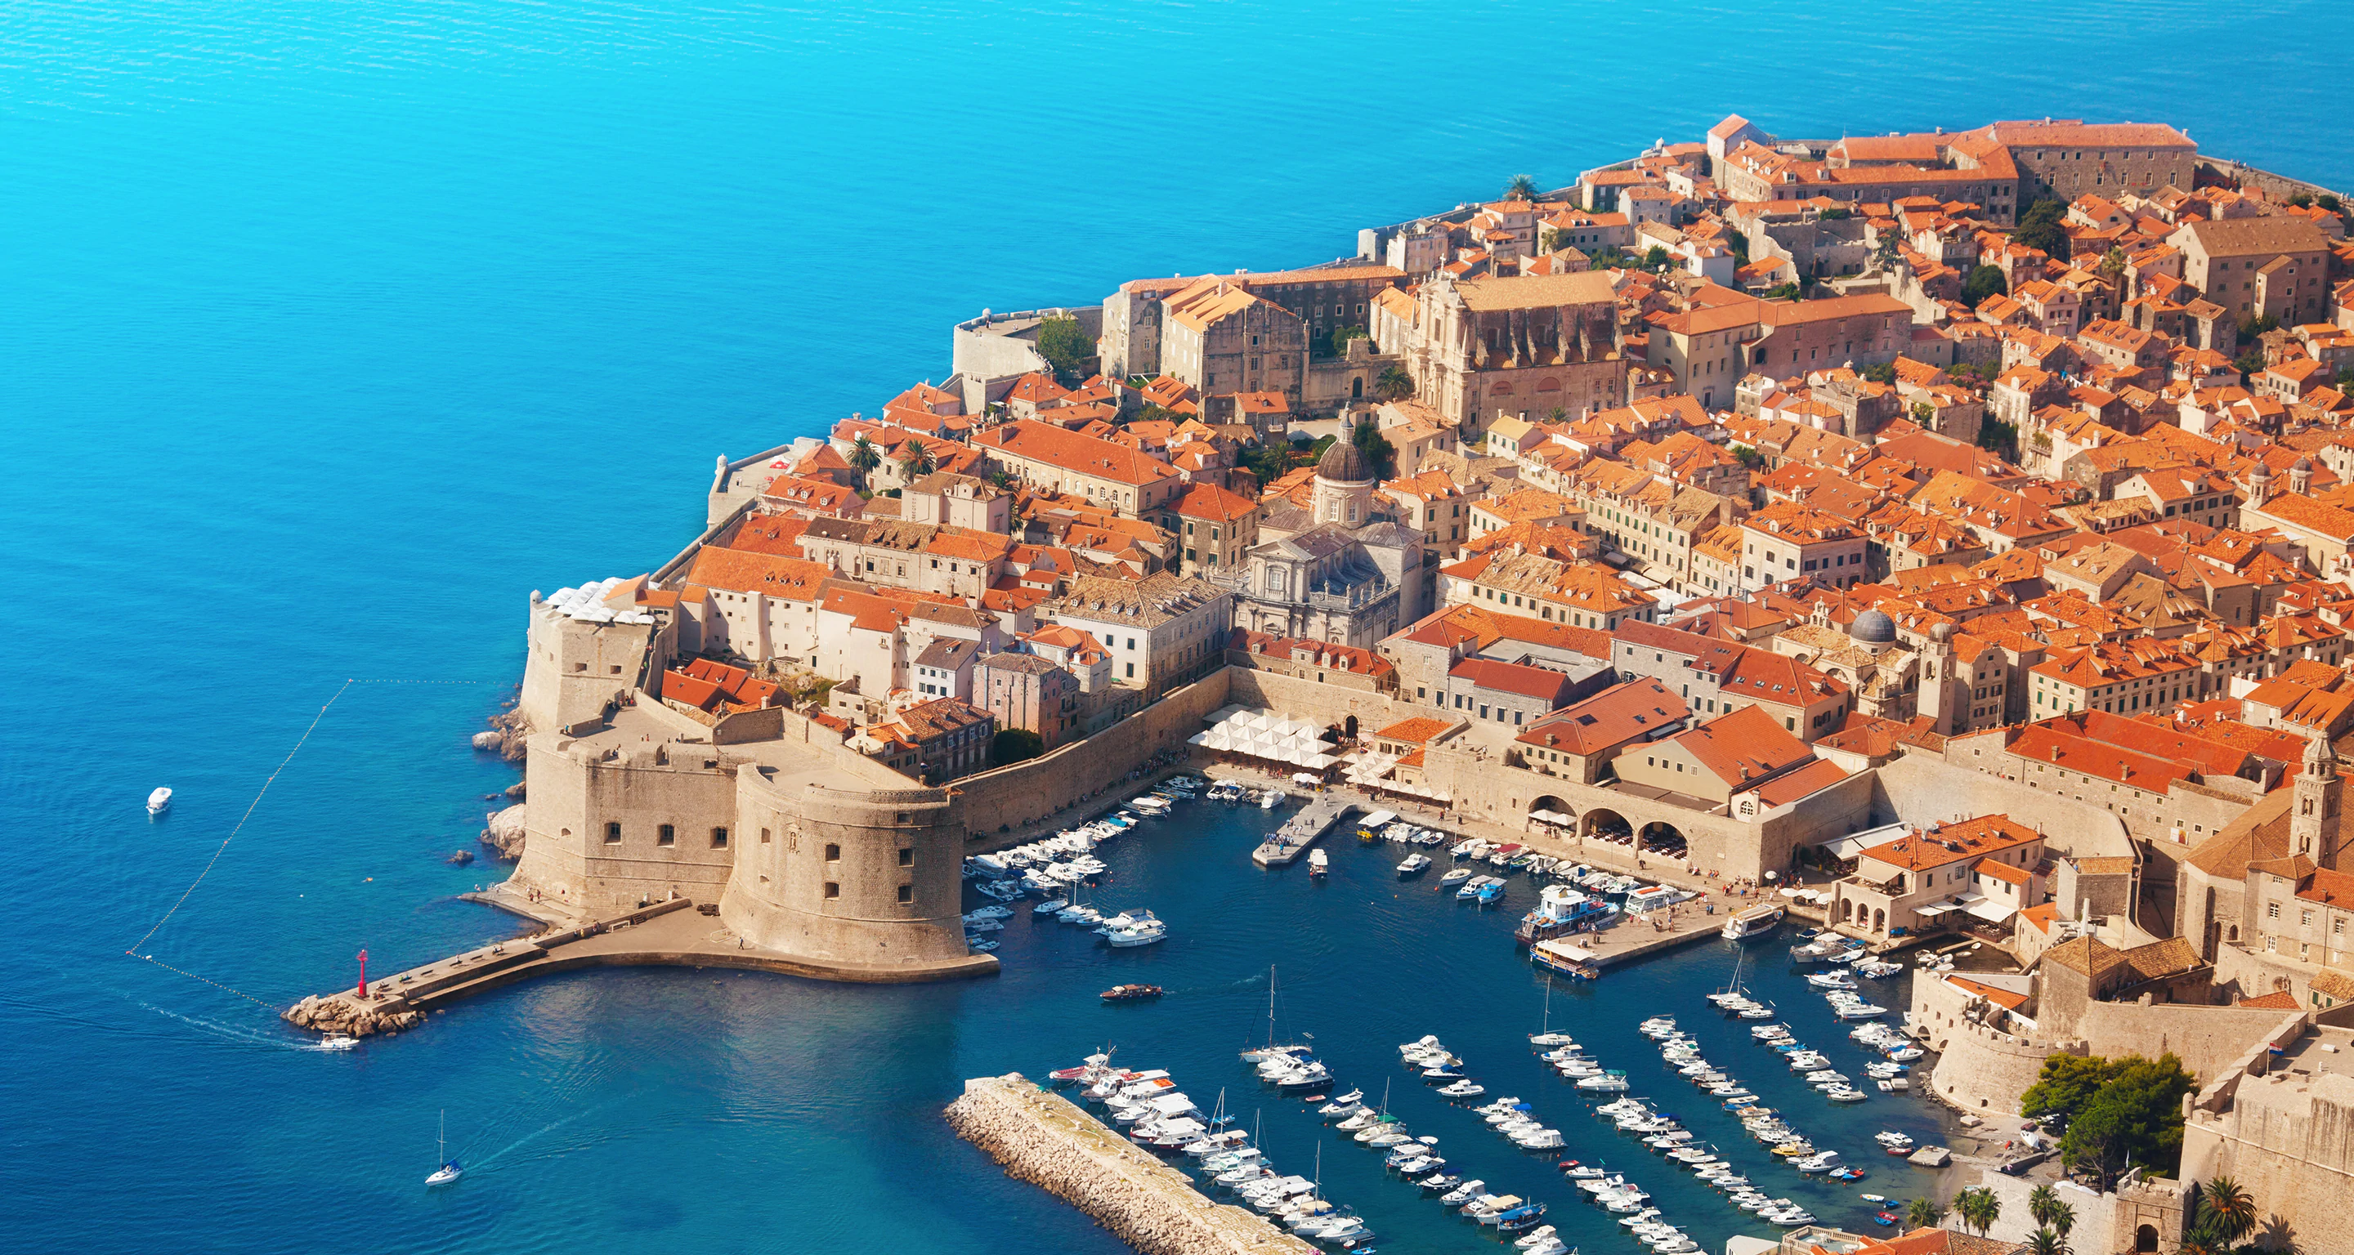
The first quarantine and first lazaretto?
Port city of Ragusa (modern-day Dubrovnik) was the first to pass legislation requiring the mandatory quarantine of all incoming ships and trade caravans in order to screen for infection
The order from July 27, 1377, the city’s Major Council passed a law “which stipulates that those who come from plague-infested areas shall not enter [Ragusa] or its district unless they spend a month on the islet of Mrkan or in the town of Cavtat, for the purpose of disinfection.” (History network, 2020)
Most likely the first city to set up a temporary plague hospital on another island called Mljet (History network, 2020)
would soon become known throughout Europe as a lazaretto.
Notes:
The ordermiraculously survived in the Dubrovnik archives.

Slide 17
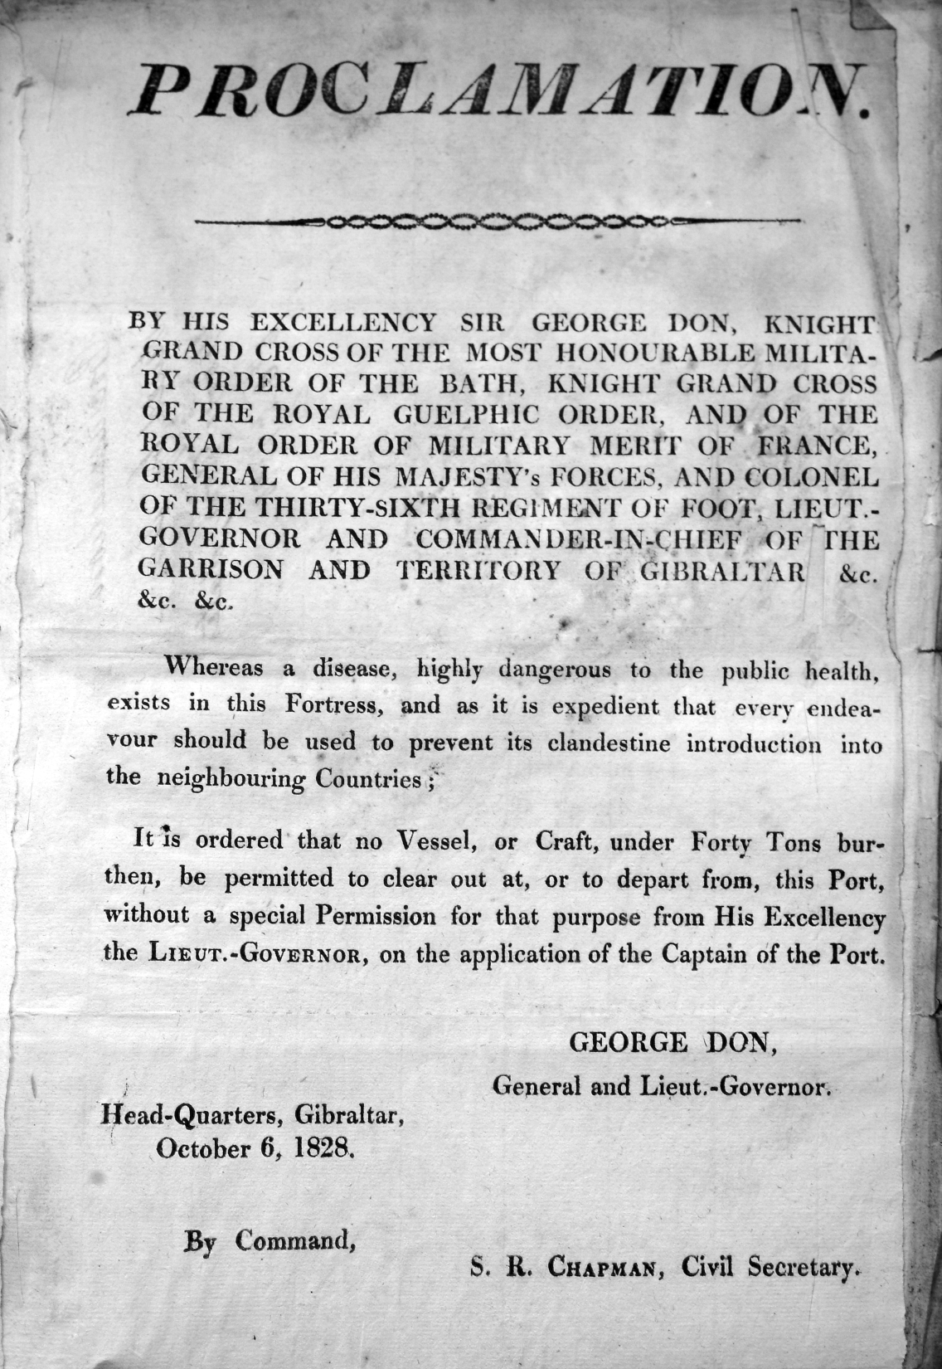
Example of Adoption of Quarantine procedures involving people and goods arriving by sea and land in Gibraltar 1828

Slide 18
Recall
Quarantine:
quarantena, meaning "forty days", used in the 14th–15th-centuries Venetian language and designating the period that all ships were required to be isolated before passengers and crew could go ashore during the Black Death plague epidemic
a state, period, or place of isolation in which people or animals that have arrived from elsewhere or been exposed to infectious or contagious disease are placed.
impose isolation on (a person, animal, or place)
Quarantine (other definitions)
Separates and restricts the movement of people who were exposed to a contagious disease to see if they become sick.
The separation of a group of people from a population and the restriction of their movement to prevent the introduction and spread of a disease.
Notes:
Related to quarantine is ostracism of those who are ill or perceived to be ill.

Slide 19
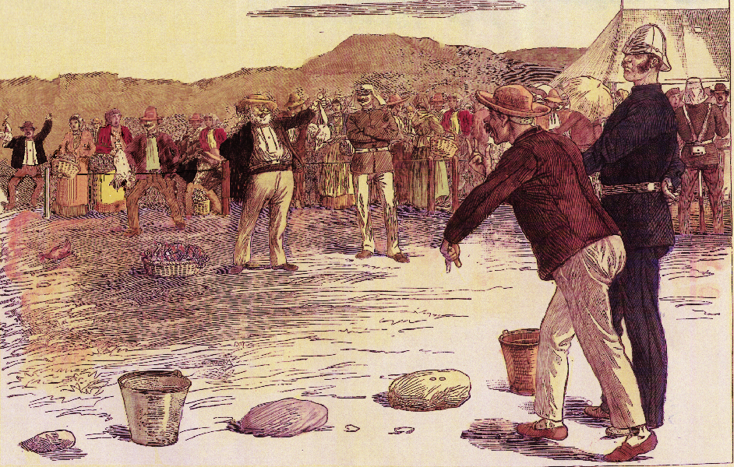
Cordon sanitaires
Pallenque: the establishment of a special marketplace where food and supplies could be procured
Notes:
Quarantine of whole villages/towns. This depiction is of a controlled market setting in Gibraltar, during a cholera pandemic

Slide 20
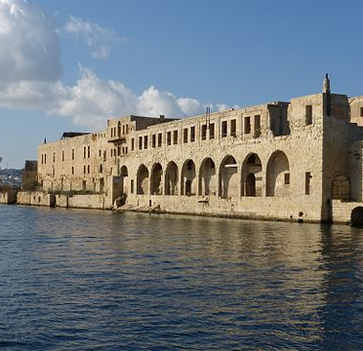
Lazarettos
Lazarettos were located far enough away from centers of civilization to restrict the spread of disease but close enough to transport the sick (Tognotti, 2013)
Where possible, lazarettos were located so that a natural barrier, such as a body water, separated them from the city
When natural barriers were not available, separation was achieved by encircling the lazaretto with a moat or ditch
In ports, lazarettos consisted of buildings used to isolate ship passengers and crew who had or were suspected of having plague.
First permanent Lazaretto? Santa Maria di Nazareth was on the Venetian Lagoon in 1423
In 1476 in Marseille, France, a hospital for persons with leprosy was converted into a lazaretto.
Notes:
The name lazaretto is a corruption of the word Nazaretto, the nickname for the lagoon island upon which Venice built its first permanent plague hospital. Pictured here is lazaretto on an island outside the capital city of Valletta, on Manoel island.

Slide 21
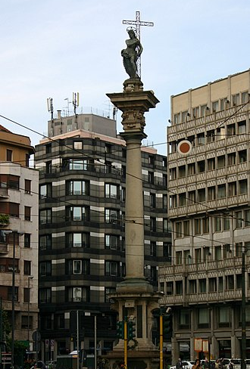
Religion, persecution, and commemorations of the plague
The Verziere column in Milan
it was meant both a votive offering to celebrate the end of the epidemic of plague that occurred in Milan in 1576-1577
and was a symbol of the power of Christianity to be opposed to the malicious power of the witches that were believed to inhabit the neighbourhood
Notes:
Some Europeans targeted "various groups such as Jews, friars, foreigners, beggars, pilgrims", lepers, and Romani, blaming them for the crisis. Lepers, and others with skin diseases such as acne or psoriasis, were killed throughout Europe.
Because 14th-century healers and governments were at a loss to explain or stop the disease, Europeans turned to astrological
forces, earthquakes, and the poisoning of wells by Jews as possible reasons for outbreaks

Slide 22
The Black death: Second pandemic
The death toll is probably beyond any estimates, especially since there were many parts of the world where there were not any written records (Green, 2018)
Human louse (P. humanus) and Human flea (P. irritans)
Human to human
Transmission: Indirect insect ectoparasite vector
Most likely applies to the Justinian pandemic as well
Fast pace of spread of epidemic, where all inhabitants were infected in one household, but none in another
Fleas can survive for long periods without feeding in clothes, bedding, wool
Evidenced by only a few archaeological excavations of rats, and some areas with no rats in Norway and other Nordic countries
This Photo by Unknown Author is licensed under CC BY-NC-ND
Notes:
Some estimates say that 60% of Europe died of the plague during the peak (1346-1353)
Thus, the disease ca can survive long distances. Use modeling to see which mode of transmission best coincides with disease rates. Rats still are important for later pandemic and in Asia.

Slide 23
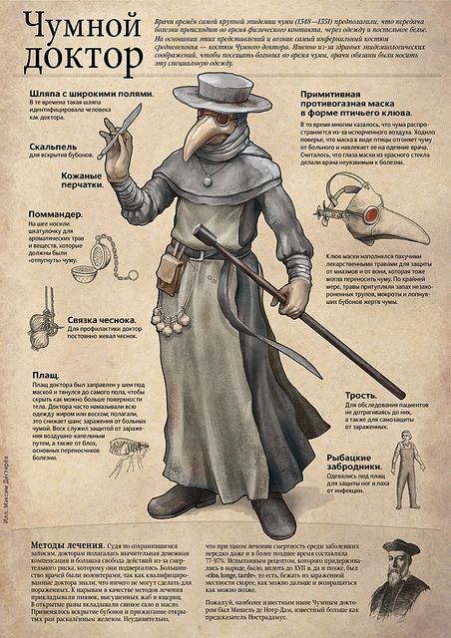
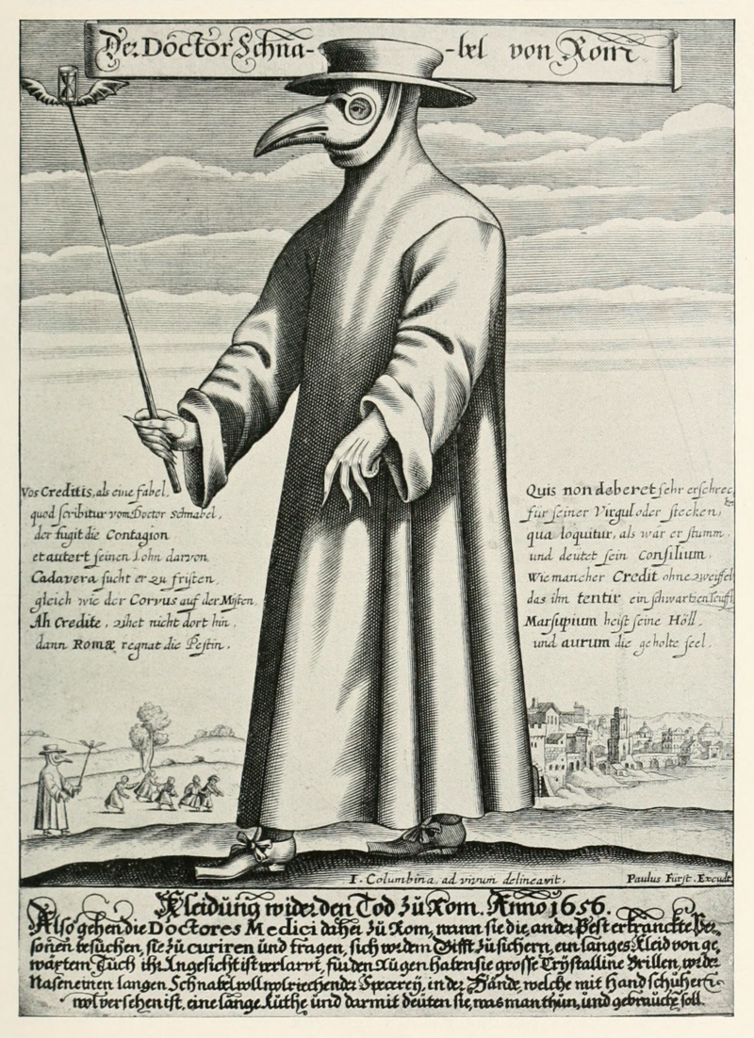
Plague doctors of 16th and 17th centuries
This style of dress with a waxed canvas or leather: long gown, overcoat, leggings, boots, gloves; hat; cane; bird-like mask; and spectacles was designed by, Charles de L’Orme in 1619

Slide 24
1650 or 1750 plague mask
From the Deutches Historiche Museum in Berlin Germany
https://www.washingtonpost.com/travel/2020/04/22/tweet-asked-museums-show-off-their-creepiestobjects-dear-god-did-they-deliver/
Notes:
1650 or 1750 plague mask

Slide 25
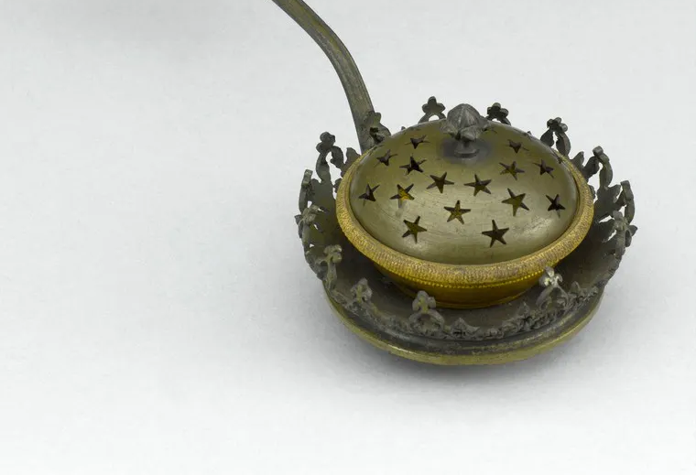
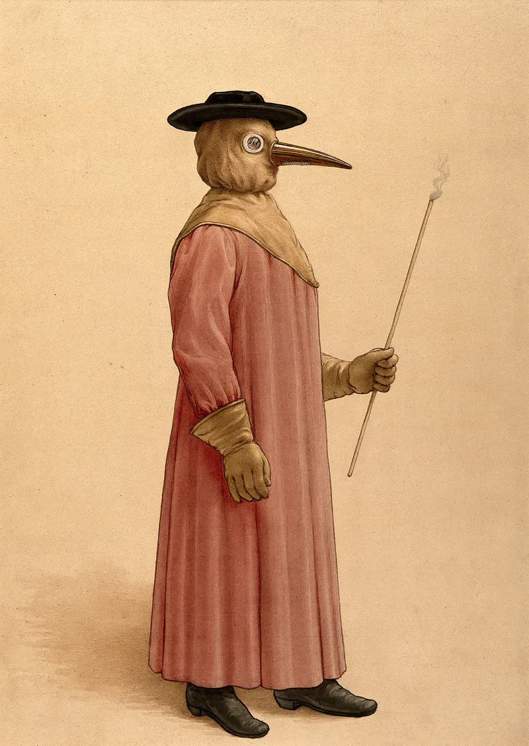
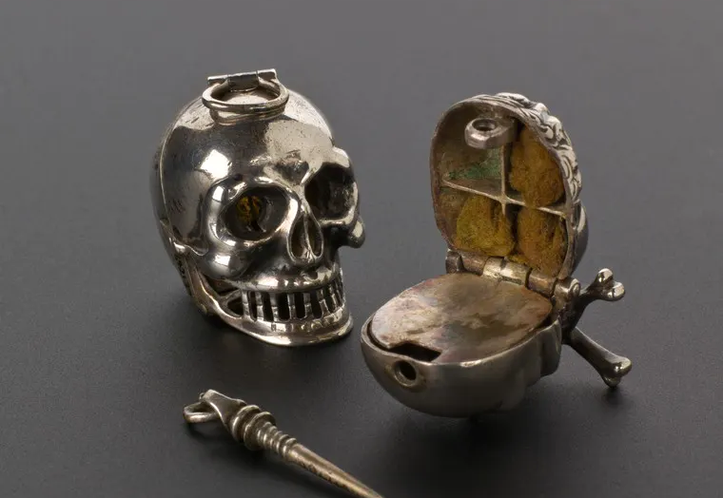
16th and 17th centuries plague “remedies”
https://wellcomecollection.org/articles/XGaG2hAAANfAsTGg
Source: Science Museum. Attribution 4.0 International (CC BY 4.0)
Notes:
Realistic depiction of a plague doctor

Slide 26
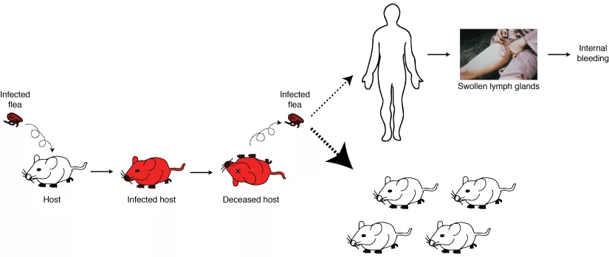
The third pandemic Rat “falls”-massive deaths of rats in the streets
http://sitn.hms.harvard.edu/flash/special-edition-on-infectious-disease/2014/plagues-of-the-past/
Notes:
This rat-flea vector borne transmission is most likely the disease spread based on the mortality rates, and would explain how quickly the disease spread

Slide 27
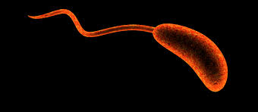
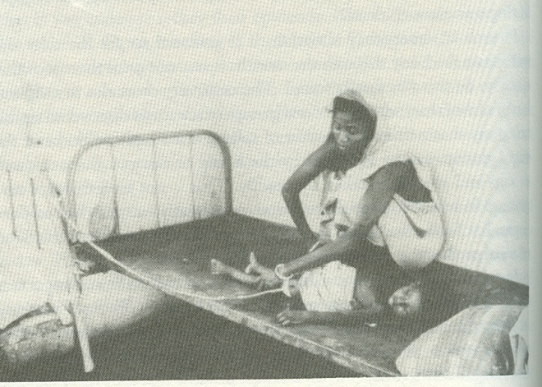
CHOLERA
Caused by the toxin produced by the bacterium Vibrio cholerae upon colonization of the human small intestine
the bacterium produces toxin that invades the cells causing violent diarrhea and vomiting, rapid heart rate, loss of skin elasticity, low blood pressure, thirst, and muscle cramps
Death occurs primarily through dehydration
In the 1950, Dr Sambhu Nath De, a Calcutta-based scientist (present-day Kolkata), played a fundamental role in discovering the cholera toxin (enterotoxin).
Clinical observations showed “that dehydration was a sufficient cause of pathology of cholera that the cholera toxin can kill ‘merely’ by stimulating the secretion of water into the bowel.” (Wangchuk, 2019)
Notes:
Not everyone with Cholera will experience symptoms
averages about 1 in 10 people with Cholera will experience symptoms. Indirect transmission: fecal-oral transmission
common vehicle (e.g. eating contaminated food or drinking contaminated water), and contact with surface/skin carrying fluids

Slide 28
Notes:
In 1883, German microbiologist Robert Koch, the founder of modern bacteriology, studied cholera in Egypt and Calcutta. He developed a technique allowing him to grow and describe V. cholerae

Slide 29
CHOLERA
Within the family of micro-organisms causing cholera, there are 139 serotypes
of these only 2 have the capability of causing the disease in humans
type 01 and type 139
01 has the classical form and El Tor
El Tor is the causative agent of the 7th pandemic

Slide 30
CHOLERA PANDEMICS
Not all cholera epidemics are of equal weight in terms of mortality
At times, a cholera epidemic can fall well outside the range of normal variation in mortality

Slide 31
C1911
116C 85D
CHOLERA PANDEMICS IN MALTA
C1887
471C 352D
C1867
403C 259D
C1865
2807C 1732D
C1850
4029C 1736D
C1837
8785C 4252D

Slide 32
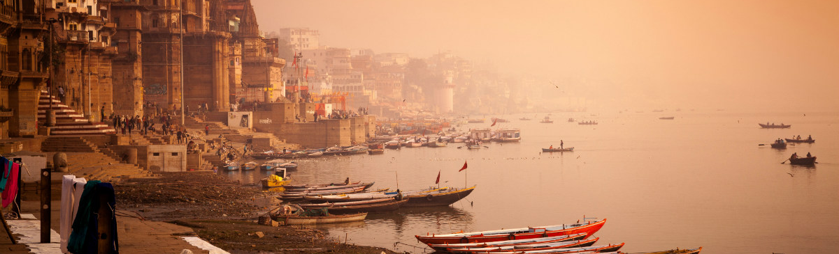
1st Pandemic 1817-1823
https://www.passporthealthglobal.com/2018/02/the-history-of-cholera-and-the-ganges-delta/
Affected every country in Asia –Originated in the Ganges river
The spread of the epidemic was greatly facilitated by British troops
Spread rapidly and noted for its high virulence
Well over 100,000 cases (est. >100 000 died on the island of Java) (CBC, 2010)

Slide 33
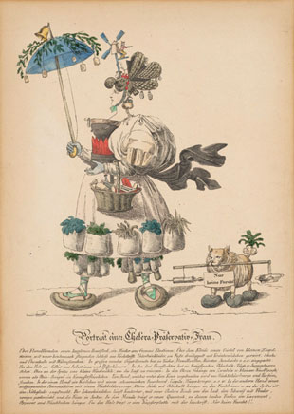
2nd Pandemic: 1826 to 1837
Like the first, the pandemic most likely originated in the province of Bengal in northeast India
Unlike the first, it reached Europe & N.A.
In Canada it arrived with Irish immigrants fleeing the potato famine (CBC, 2010)
The epidemic was spread in part by soldiers, pilgrims, and travellers
(The Scientist, 2013)
Notes:
This depiction (from around 1832) is of a woman’s attempts to repel cholera satirizes the abundance of dubious advice about prevention.

Slide 34
3rd pandemic: 1852-1859
The third pandemic, generally considered the most deadly
Devastated large areas of Asia, Europe, North America and Africa.
In 1854, the disease took a great toll on Britain: 23000 died (CBC, 2010)
Notes:
Originated once again in India.

Slide 35
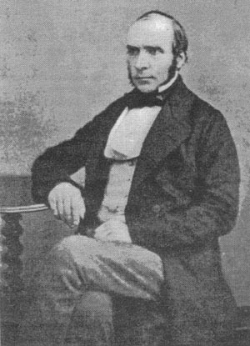
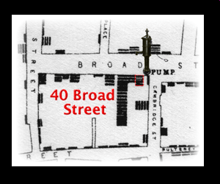
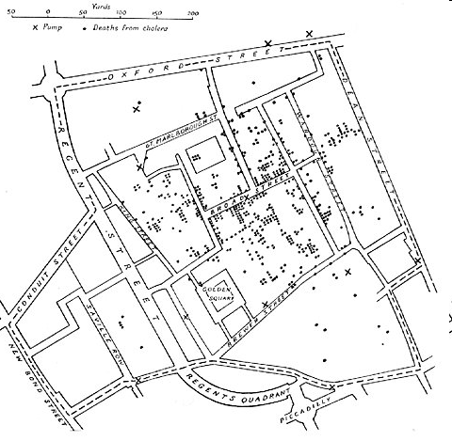
History

Slide 36
4th pandemic: 1863-1879
The fourth pandemic began in the Bengal region from which Indian
Muslim pilgrims visiting Mecca spread the disease to the Middle East
From there it migrated to Europe, Africa and North America
At least 30,000 of the 90,000 Mecca pilgrims victim contracted the disease
Cholera claimed 90,000 lives in Russia in 1866 (CBC, 2010)
Notes:
Many of the poor didn’t want to vaccinate their children

Slide 37
Cholera syndemic in Gibraltar: 1865
In Gibraltar, the whole population was quarantined, imposed by Spain: Sanitaire cordon
The epidemic showed evidence that protective measures can promote inequities
The poor suffered from both smallpox and cholera, and lack of access to clean water
Notes:
The poor did not trust vaccinations

Slide 38
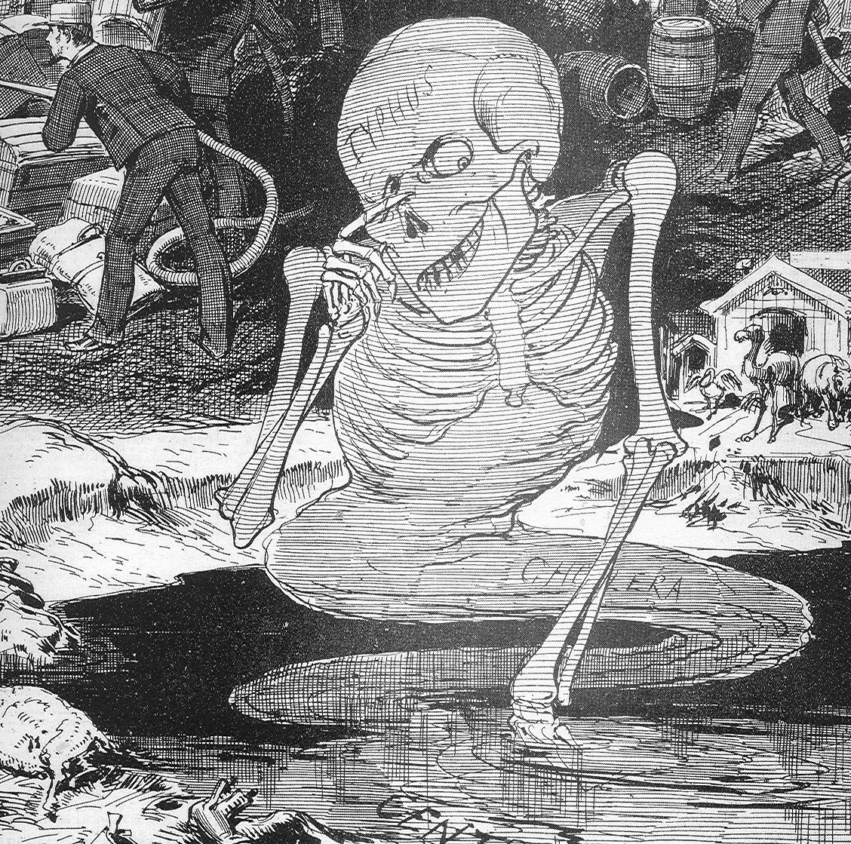
Miasmatic Origins
“cholera
Arising from
Local conditions”

Slide 39
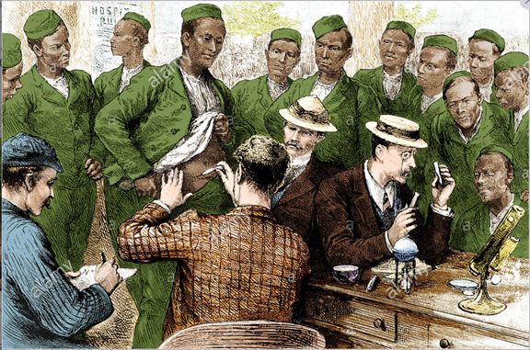
5th pandemic: 1881-1896
Swept through Asia, Africa, South America and parts of France and Germany.
The 1892 outbreak in Hamburg, Germany claimed about 8,600 lives
Cholera claimed 200,000 lives in Russia between 1893 and 1894
Killed 90,000 in Japan between 1887 and 1889
Quarantine measures based on the findings of John Snow kept cholera out of Britain and the United States.
In 1892, Waldemar Haffkine, a Ukrainian bacteriologist who worked mostly in India, developed a human vaccine for cholera
Cholera vaccination of the Third Gurkhas in India at the time of the 1893 epidemic. Source (alamy, 2020)
Notes:
The fifth pandemic originated in the Bengal region of India.

Slide 40
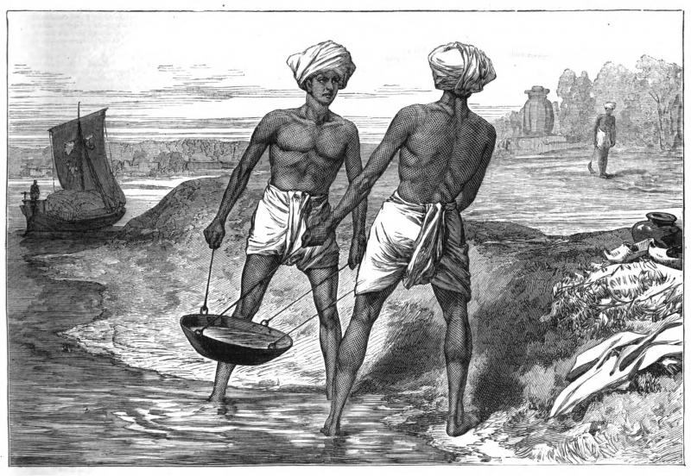
5th pandemic: 1881-1896
http://www.environmentandsociety.org/exhibitions/famines-india/infrastructure-and-railroads
MARY EVANS PICTURE LIBRARY

Slide 41
Cholera the great sanitary reformer
‘shock disease’
Riots occurred because there were fears that medical students and doctors were taking advantage of cholera to obtain bodies for their anatomy classes
it was also rumoured that they were killing cholera victims

Slide 43
References
CBC (2010, Oct). Cholera's seven pandemics. Retrieved from https://www.cbc.ca/news/technology/cholera-s-seven-pandemics-1.758504
Cossins, D. (2013, Jan). Cholera Confusion, circa 1832. The Scientist. Retrieve https://www.the-scientist.com/foundations/cholera-confusion-circa-1832-39849
Green, M. H. (2018, March). On Learning How to Teach the Black Death, HPS &
ST Note. Retrieved https://www.hpsst.com/uploads/6/2/9/3/62931075/2018march.pdf
Harvard University, (2014, Dec 31). Plagues of the Past. Retrieved from http://sitn.hms.harvard.edu/flash/special-edition-on-infectious-disease/2014/plagues-of-the-past/
History Canada (2020, May 23). Social Distancing and Quarantine Were Used in Medieval Times to Fight the Black Death. Retrieved from https://www.history.com/news/quarantine-black-death-medieval
Omran, A. R. (1971). The epidemiologic Transition: A Theory of the Epidemiology of Population Change. Millbank Memorial Fund Quarterly, 49, 509-538.

Slide 44
References
Omran, A. R. (1998). The epidemiologic transition theory revisited thirty years later. World health statistics quarterly, 51, 99-119.
Tognotti, E. (2013). Lessons from the history of quarantine, from plague to influenza A. Emerging infectious diseases, 19(2), 254.
Wangchuk, N. R. (2019, Oct) Refused a Nobel, This Unsung Indian Scientist’s Research Saved Millions of Lives, The Better India. https://www.thebetterindia.com/198411/indian-nobel-prize-scientists-cholera-toxin-sambhu-nath-de/
Washington Post. (2020, May 23). A tweet asked museums to show off their #CreppiestObjects and dear God, did they deliver. Retrieved from https://www.washingtonpost.com/travel/2020/04/22/tweet-asked-museums-show-off-their-creepiestobjects-dear-god-did-they-deliver/
Wellcome Collection (Amelia Soth) (2019, Feb 19). Deadly stinks and life-saving aromas in plague-stricken London, Inside Our Collections. Retrieved from https://wellcomecollection.org/articles/XGaG2hAAANfAsTGg

