Slide 1
Influenza pandemics
ANTH298: Pandemics past & present
May 2019

Slide 2
Epidemic types
A common source epidemic can be defined as the by-product of exposure to a common infectious agent.
  Continuous: when individuals are exposed to a common source over a longer period of time
  Point-source: a group of individuals is exposed to a common pathogen at the same time and place (e.g., at a church, picnic, or restaurant), over a very brief period.

Slide 3
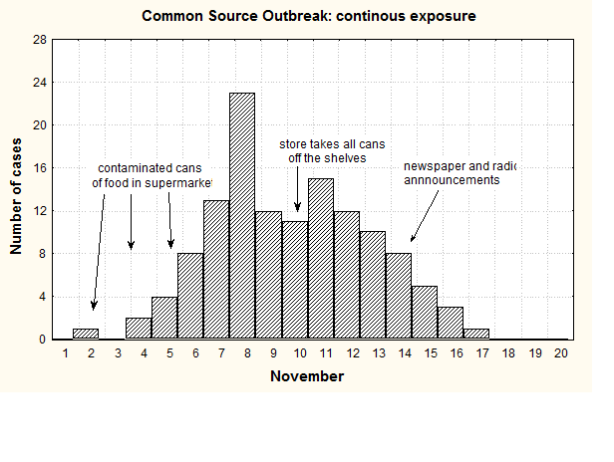
Continuous, common source epidemic

Slide 4
Point-source, (common source) epidemic

Slide 5
Propagating (contagious) epidemic
One that does not have a common source but rather spreads more gradually from person to person, typically in a cumulative fashion
The epidemic curve reflects a series of peaks indicative of a growing number of cases

Slide 6
Cyclical epidemics
Example: measles
  Three types dependent on (1) population size and (2) the degree of isolation
  Type I
    Large urban populations (size >250,000)
    epidemic waves are described as regular and continuous
    measles cases never reaches zero (measles is endemic)

Slide 7
Cyclical epidemics
Example: measles
  Type II
    urban populations (size <250,000)
    Wave are regular but discontinuous
    disappears completely from the community and must be re-introduced from an individual in another community
    timing cycle between epidemics varies with the size of the population
    susceptible individuals is influenced by: the birth rate, the number of immigrants to the population and the proximity to larger populations where the virus may be found
  Type III
    Epidemics are usually triggered by the importation of the disease by an infective to the community
    Once the virus has run out of suspectibles, measles disappears

Slide 8
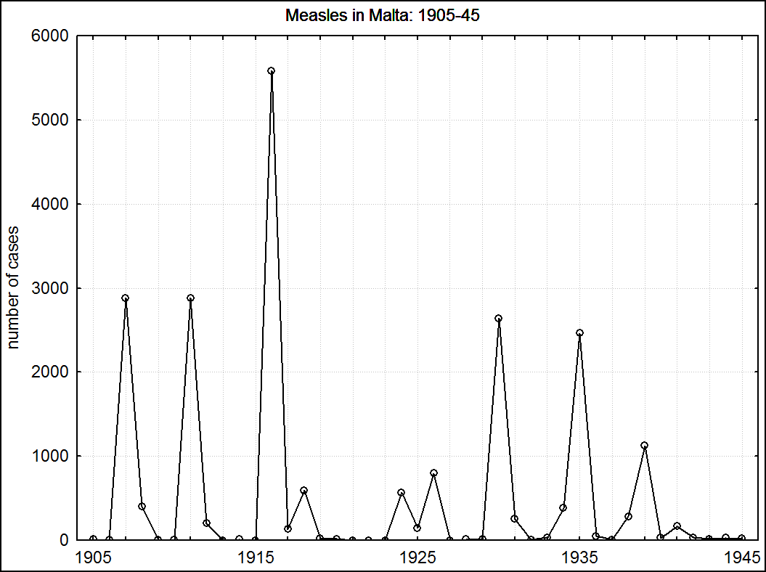

Slide 9
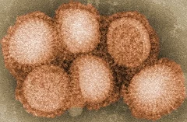
Influenza Viruses
Family: Orthomyxoviridae
  RNA viruses: not living organism
    Need to acquire energy from their environment to allow them to assemble and procreate, and they have to transmit the instructions for making themselves to their progeny (Rader, April 2020)
https://www.princegeorgecitizen.com/opinion/columnists/inside-an-rna-virus-1.24115721?utm_campaign=magnet&utm_source=entity_page&utm_medium=related_articles

Slide 10
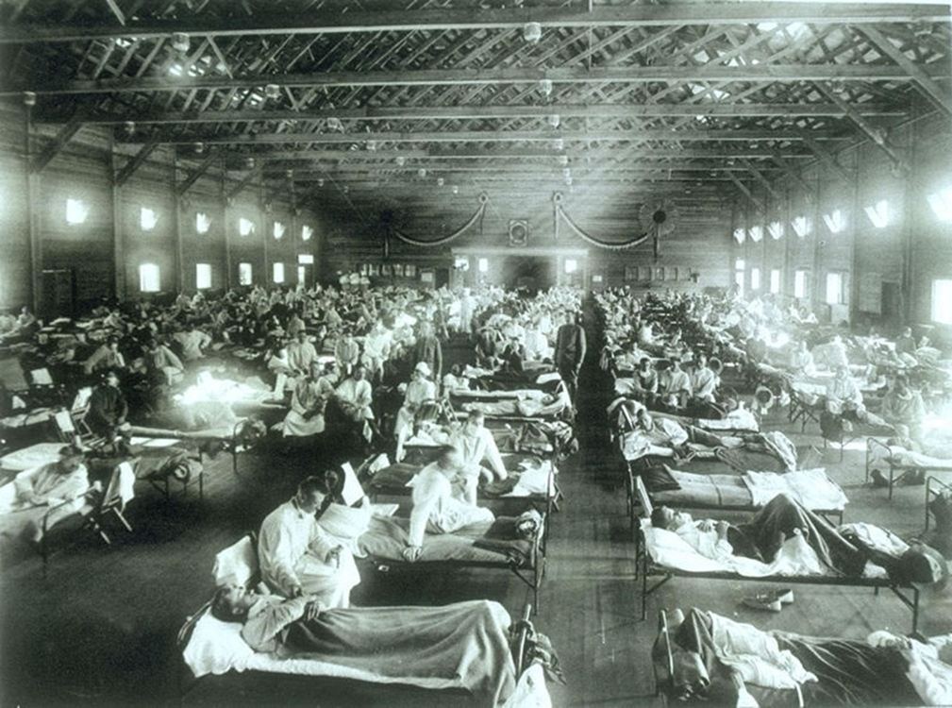
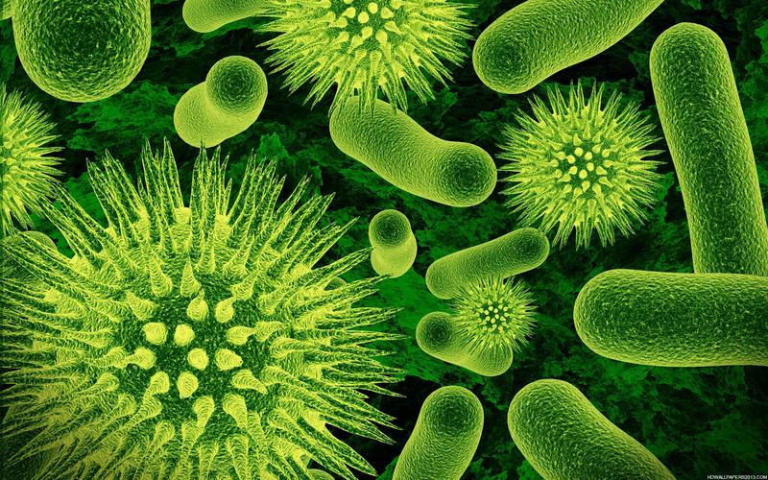
Geographical origin of the 1918 pandemic virus?
Exact location of origin is not known; most likely location is Haskell County, Kansas (Camp Funston, now Fort Riley) (Barry, 2004)
(Kongsivinger Museum, n.d.)
Hospital ward at Camp Funston, Kansas ( http://www.army.mil/-images/2008/09/24/22729/army.mil-2008-09-25-103608.jpg)

Slide 11

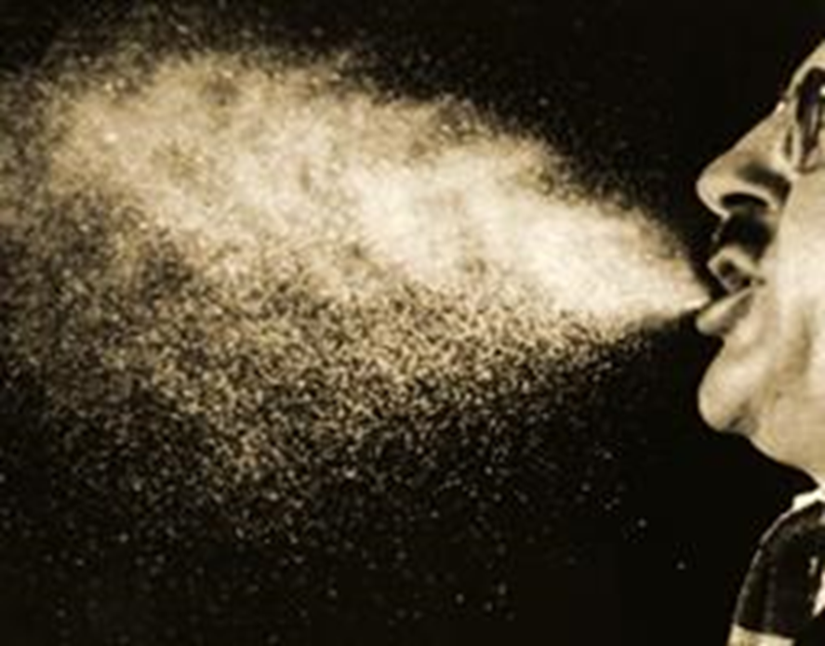
How does one catch the “flu”?
Human virus strains evolve rapidly given these favourable conditions
  Respiratory transmission: high levels of person-to-person transmission
    From sneezing or coughing (airborne) or through contact with fomites (inanimate objects)
  Indoor lifestyle
  Crowding
(http://www.trackingzebra.com/new-blog/2015/1/5/gom2xqb8tiknm5cygf00fl08e3v5gc)

Slide 12
1918/19 influenza: Why was it an event of historical significance?
Considered the last “great pandemic”
1. Very large number of clinical cases around the world (e.g., US =25%; This rate was also observed in the military stationed at Malta)
2. Extremely high mortality rate
3. Flu transmissible from animals to humans
  Closest to avian strain as well as swine strains
  (Noymer & Garenne, 2000)
4. Age differences – W shaped, whereas other influenza epidemics killed the young & old at higher rates

Slide 13
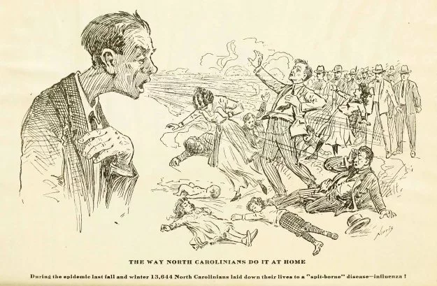
2. Extremely high mortality rates
The last of the “great pandemics” and one of the most deadly
Killed 17.5-100 million people (Kroneman & Paget, 2017)
  It is possible that influenza persisted or reappeared in 1920/21 (Johnson & Mueller, 2002)
    Killing upwards of 24 million
  Contemporary pandemics such as “Asian Flu” (1957/58) and “Hong Kong Flu” (1968/69), are estimated to have killed 1.4 million and 1.7 million, respectively
(The Health Bulletin, North Carolina, 1919)

Slide 14
T33. Animal to human transmissionType A
There are four types of influenza viruses: A, B, C and D
Influenza A viruses are the only influenza viruses known to cause flu pandemics
Wild Birds are primary natural reservoir for all subtypes in Influenza A
Found in different animals
  Ducks
  Chickens
  Pigs
  Whales
  Horses
  Seals

Slide 15



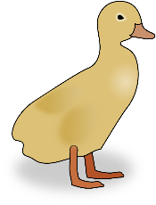
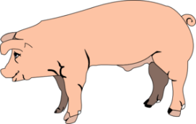

T33. Animal to human transmission
A novel strain of A(H1N1)- originated in birds, mutated or “cross-over” to “swine flu” and then jumped to humans
  In 2009, a derivative of the 1918 A(H1N1) lineage, surfaced in Mexico: the 2009 A(H1N1) virus

Slide 16
3. Antigenic drift and Antigenic shift
https://www.nzherald.co.nz/nz/news/article.cfm?c_id=1&objectid=12124446

Slide 17
4. W-shaped age mortality curve
Unlike seasonal influenza, young-adults died at elevated rates compared to teenagers and middle-aged adults
  Appx. 50% of those who died were young healthy adults
  In Malta 51% of men aged 25-49 years died of influenza; 55% of Maltese women 15-34 years died of influenza)
United Stated of America (Taubenberger & Morens, 2009)

Slide 18
4. Explanations for why young adults had high mortality
Original antigenic sin hypothesis: When the body first encounters an infection it produces effective antibodies against its dominant antigens and thus eliminates the infection.
  When it encounters the same infection, late, with a new dominant antigen, the immune system will still produce the former antibodies against this old "now recessive antigen" and not develop new antibodies against the new dominant one
  Results in the production of ineffective antibodies and thus a weak immunity.
TB & influenza interaction: Deleterious consequences of concomitant tuberculosis and influenza infection
  Higher male mortality during the 1918 influenza pandemic and therefore cannot be extended to other parts of the world where females died in greater proportion than males

Slide 19
4. Explanations for why young adults had high mortality
Cytokine storm: An overactive immune response, which was not only insufficient for protection but ultimately caused a highly pathogenic respiratory infection that killed them
T-cell dysregulation: Individuals exposed at least once to the (presumably) A/H3N8 flu 1889–90 pandemic strain were likely to have dysregulated cellular immune responses to infections with the A/H1N1 strain during the 1918 outbreak
  The immunopathologic effects might have increased susceptibility to lethal secondary bacterial pneumonia

Slide 20
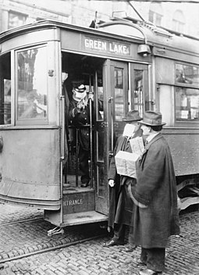
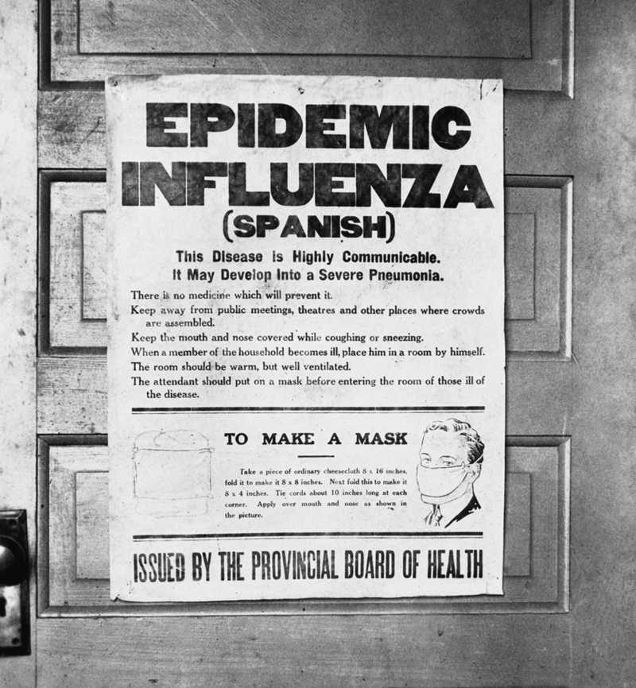
The American experience: epidemic curves
Not a homogenous experience
Note similar mitigation strategies to COVID-19
A streetcar conductor in Seattle in 1918 refusing to allow passengers aboard who are not wearing masks (Wikipedia, 2020)

Slide 22
The Australian experience
Curson & McCracken, 2006

Slide 23
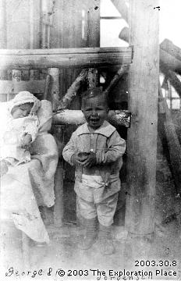
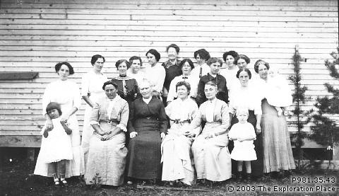
Influenza in PG
Tool kit for high school students, provides some context: https://libguides.unbc.ca/1918_flu_epidemic/deaths
Approx. 80 deaths in the Fort George region
Central School, Fort George, B.C. 1914. The school was used as a hospital during a flu epidemic in 1918
(Exploration Place, 2003.30.8)
(Exploration Place, P981.35.43)

Slide 24
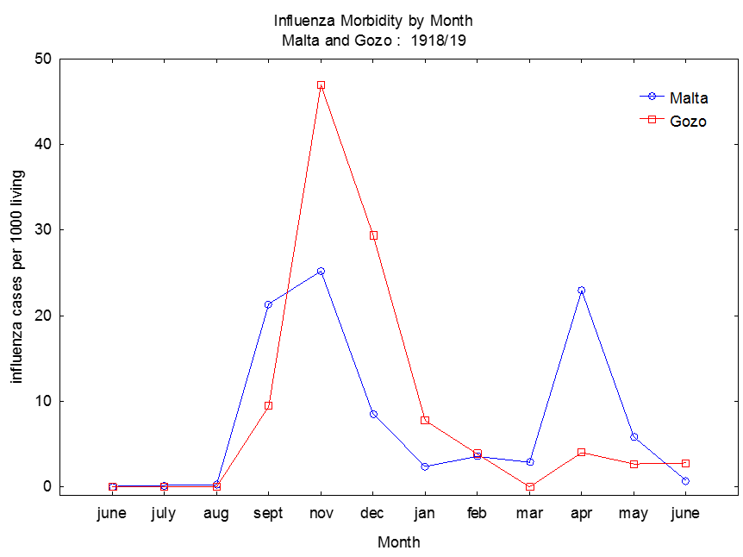
Malta vs. Gozo: Variation in the morbidity experience
Herald Wave: Summer 1918 (June 9th- Aug)
Wave 2: Fall 1918 (Sept-Nov)
Wave: Winter 1919 (Dec-May 31st1919)
Figure 2. Monthly influenza morbidity rates in Malta and Gozo during the 1918/19 pandemic

Slide 25
Variation in the morbidity experience
Overall, Gozo experienced higher morbidity rates than Malta
  Surge of cases in Gozo during wave 2: 83.9 per 1000 versus 56.6 per 1000 in Malta
  There were significant differences in rates for both rural and urban Malta versus Gozo (p< 0.05)
  During wave 3, Malta’s rates were nearly double that of Gozo: 43.6 per 1000 and 22.4 per 1000 respectively.

Slide 26
Why the difference in illness between the two islands?
Elements of isolation, exposure history and rurality
  Gozo is unique in its extreme degree of biological and social isolation where less than 1% of the population immigrated from abroad (Government of Malta 1912a; 1922)
  The infrequent exposure to bouts of seasonal influenza limited Gozo’s herd immunity to influenza and similar A(H1N1) type viruses
  Gozo was less densely populated and did not experience a herald wave (in the summer 1918); they experienced a heightened fall wave compared to Malta

Slide 27
Syndemic defined
The comorbidity of two of more diseases or health conditions in which there is interaction of the diseases that “exacerbates the negative health effects of any of all of the diseases involved.” (Singer et al., 2017, pg. 941)

Slide 28
Syndemic potential
For October (the peak morbidity month), we examined the relationship with respiratory tuberculosis
For Malta, there was an excess of respiratory tuberculosis deaths
Monthly correlations of tuberculosis cases in Malta with influenza morbidity, by town, (Rho=0.58, p <0.001), provides further evidence of the synergistic interaction of influenza and tuberculosis
Figure 3. Log tuberculosis death rates from 1910 to 1929 for the Maltese islands

Slide 29
Syndemic potential
In Gozo, there was not a relationship with tuberculosis deaths and influenza cases because tuberculosis rates remained relatively stable
Figure 4. Tuberculosis death rates from 1910 to 1929 for Malta and Gozo

Slide 30
Gender differences in morbidity rates in Gozo
Children introduced the disease into households
  First study that demonstrates children as introducers during the 1918/19 influenza pandemic
Reproductively aged females displayed the highest morbidity rates
  Because of their role as primary caregivers, females were infected at disproportionately higher rates
Figure 3. Weekly Influenza cases by age group and sex in Gozo during the 1918/19 pandemic*
*week 1 begins on Sept 15th and ends on Sept 21st; week 18 begins on Dec 29th 1918 and ends on Jan 4th 1919

Slide 31
Conclusion: Common and Non-contributory features
Poverty complex
  Overcrowding: during the early 20th century, the average number of persons per dwelling (exclusive of institutions) for Malta was 4.93 and 4.21 for Gozo (Government of Malta 1912a)
  The average number of persons per room in each dwelling for Malta was 3.2 and 3.1 for Gozo (Government of Malta 1922).

Slide 32
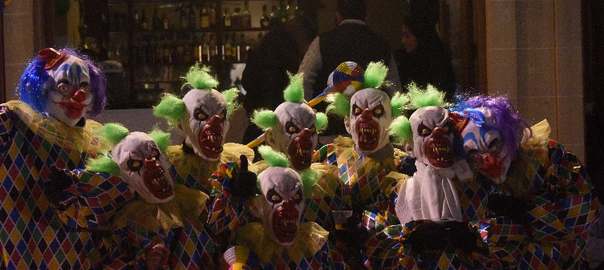

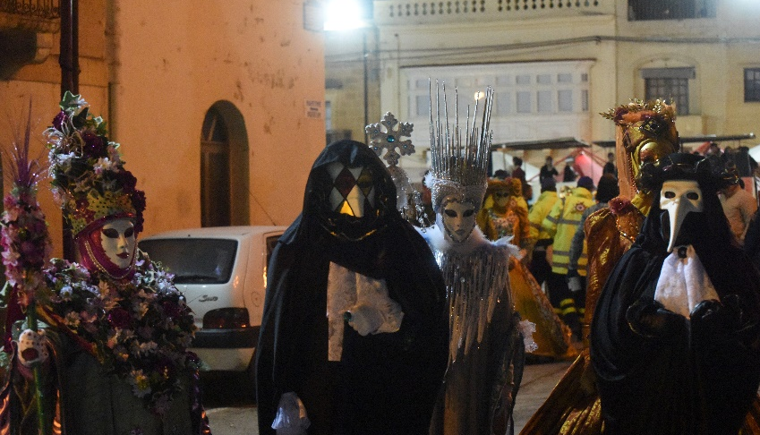
Conclusions: Common and Non-contributory features
Mass gatherings as effective means of disease transmission
  Marriages and religious festivals (e.g. il-Karnival ta' Malta) continued during the pandemic
  In Nadur, Gozo, there was a surge of cases following the festival in Feburary

Slide 33
1957 Asian influenza
  “Asian Flu” – 1957/58 – A(H2N2) – birds
    Thought to have originated Guizho; first reported in Singapore
    1.1 million worldwide 116,000 in the US
    highest excess mortality occurred in Latin America
    Symptoms: wobbly legs and a chill followed by prostration, sore throats, running nose, and coughs; together with achy limbs (adults), head (children), and a high fever (Jackson, 2009)
    CFR=0.67%

Slide 34
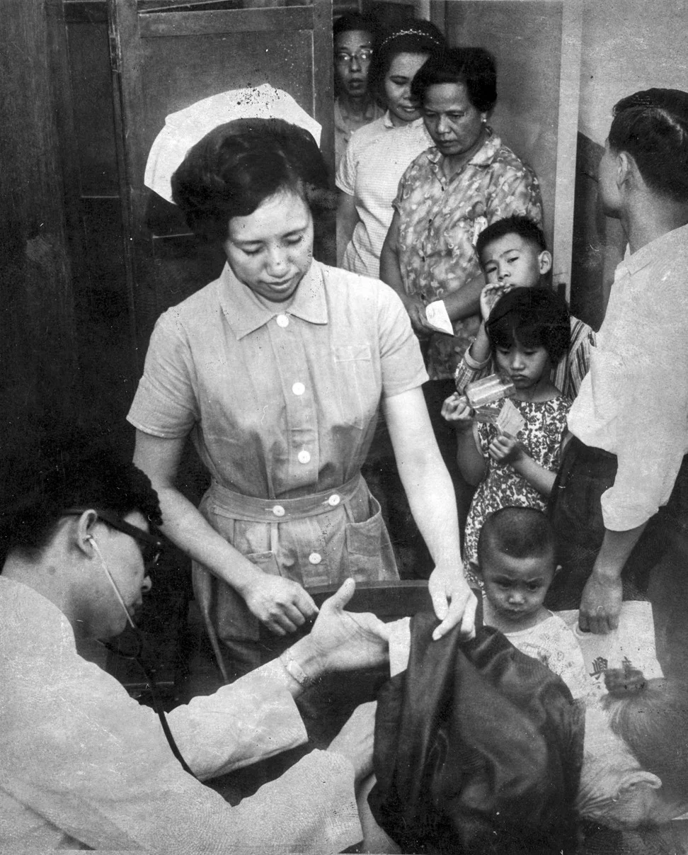
“Hong Kong Flu” – 1968/69
  “Hong Kong Flu” – 1968/69 – A(H3H2) - birds
    1 million worldwide and about 100,000 in the United States
    Most excess deaths were in people 65 years and older
    H3N2 virus continues to circulate worldwide as a seasonal influenza A virus
    Hong Kong isolated the strain and develop a vaccine
  After the two pandemics, it was erroneously believed:
    that flu pandemics tended to recur on an 11-year cycle and they were prepared for an outbreak in the late 1970s.
A government doctor and nurse cope with a steady stream of patients during the 1969 influenza epidemic in Hong Kong. (Photo: SCMP)

Slide 35
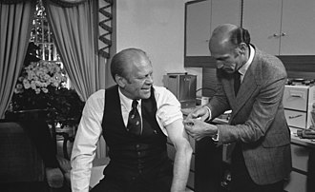
1976 influenza: The epidemic that never was
Fineberg & Neustadt, 1978
Outbreak of swine flu at Fort Dix, New jersey led to fears of a devastating pandemic
Human-to-human transmission and antigentic shift would prevent any immunity
President Gerald Ford announced a plan to vaccinate everyone in the country
  political leaders wanted to do the right thing but lacked technical expertise
  public health experts recognized the uncertainty of the threat yet wanted to convey the seriousness of the risk in a way that would overcome political inertia
40 million out of some 200 million Americans were vaccinated for the new strain
  no pandemic appeared and public health credibility suffered
U.S. President Gerald Ford receiving his vaccine for the swine flu (Wikipedia, 2020)

Slide 36
Legacies from The epidemic that never was
A Complication of the vaccination was Guillain-Barré Syndrome, which led to approximately 30 deaths
  Stopped the immunization programme in late 76
National commission on immunization policy
Liability policy
Expanded Federal role in influenza immunization

