Slide 1
Rates & other measures of disease
ANTH298: Pandemics Past & Present

Slide 2
morbidity
The occurrence of illness or diseases and is quantified as incidence and prevalence rates.
Can calculate with population at risk or person-years, (if people at risk are observed for different periods of time)
Two measures: incidence and prevalence
Incidence rate: number of new cases of a disease occurring in a population at risk of developing that disease over a specified time period
Prevalence rate: number of people in the population with a certain disease at any given point in time

Slide 3
Death rates
crude mortality rate (ie. annual mortality rate for all causes):
= Total no. of deaths from all causes in 1 year* X 1,000
Number of persons in the population at midyear
The number of persons in the population at midyear is used as an approximation of size because of changes in population size over time.
Can be misleading
*Does not have to be one year, but this is what is typically done. Also, the population at risk doesn’t have to be midyear and could be taken from a census point instead.

Slide 4
Specific mortality rates
Mortality rate can be calculated for specific age limits, sex or for a particular disease. This is known as a specific rate.
For example cause-specific mortality rate is:
= Number of deaths from a specific disease in one year* X 1,000
Number of persons in the population at midyear
Can calculate sex-specific rate, age-specific rate, or any combination of age, sex and cause
*Does not have to be one year, but this is what is typically done. Also, the population at risk doesn’t have to be midyear and could be taken from a census point instead.

Slide 5
Case- fatality rate
Case- fatality rate describes what percentage of people diagnosed as having a certain disease die within a certain time after diagnosis.
No. of individuals dying during a specified period
= of time after disease onset or diagnosis X 100
No. of individuals with the specified disease

Slide 6
Example question
In a European country with a population of 7.5 million people, 83,000 deaths occurred during the year ending December 31, 2003. These included 34,000 deaths from lung cancer in 100,000 people who were sick with lung cancer.
What is the cause-specific mortality rate from lung cancer in 2003?
What is the case-fatality rate from lung cancer in 2003?

Slide 7
Example question
What is the cause-specific mortality rate from lung cancer in 2003?
The cause-specific mortality rate from lung cancer in 2003 was:
CSR=34,000 / 7,500,000 x 1,000 = 4.5/1,000
Final statement: The lung cancer rate in the European population in 2003 was 4.5 per 1000 living individuals

Slide 8
Example question
What is the case-fatality rate from lung cancer in 2003?
The case-fatality rate from lung cancer in 2003 was:
CFR=34,000 / 100,000 x 100 = 34%
Final statement: The CFR in the European population from lung in 2003 was 34 percent.

Slide 9
Demography
The systematic study of populations, including their size, composition, and distribution and the causes and consequences (fertility, mortality, and migration) of change in those factors

Slide 10
Why is demography important for the study of disease?
Age structure of a population may help explain differences in fatality rates
The role of age structure in deaths in Italy and South Korea
Can demonstrate how the pandemic could unfold in populations with similar population sizes but different age structures
This contributed to a low overall CFR in South Korea relative to Italy (1.6% vs. 10.6%)
A dramatically higher burden of mortality in countries with older versus younger populations
Social distancing and other policies to slow transmission should consider the age composition of local and national contexts as well as intergenerational interactions

Slide 11
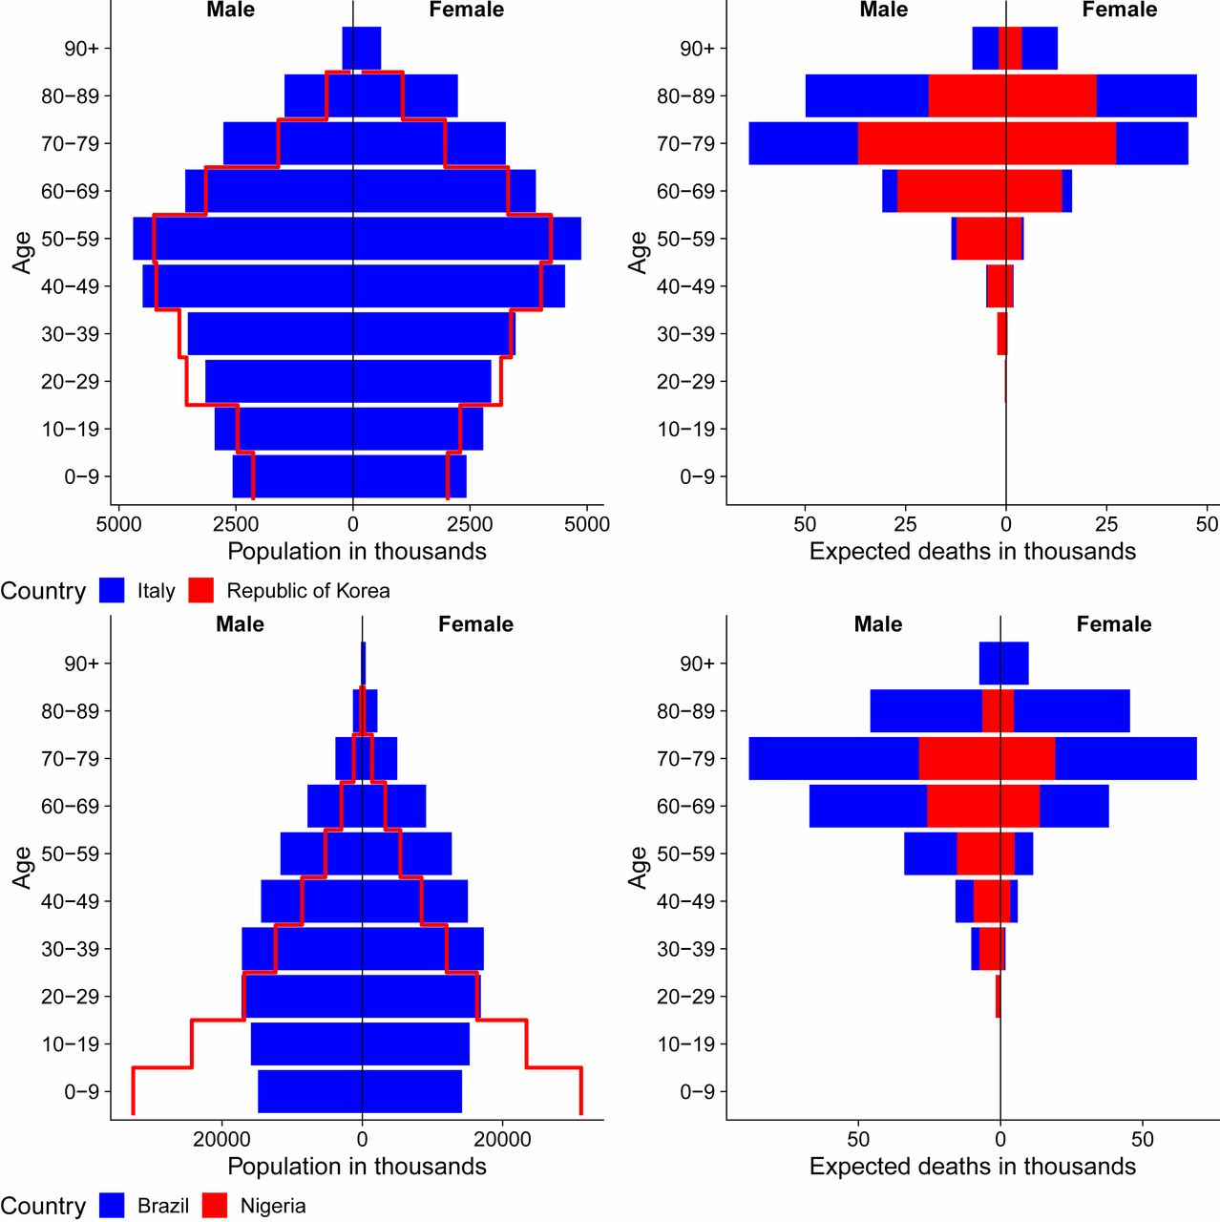
Age structure
The larger number of expected fatalities is clearly visible in Fig. 1, Top Right for Italy (302,530) versus Korea (177,822).
Brazil has 2.0% of its population over age 80+ y, with a simulated scenario leading to dramatically more deaths (452,694) compared to Nigeria (142,056), where only 0.2% are 80+ y
(Dowd et al., 2020)

Slide 12
Demographic science aids in understanding the spread and fatality rates of COVID-19 (Dowd et al., 2020)
https://movie-usa.glencoesoftware.com/video/10.1073/pnas.2004911117/video-1

Slide 13
Visualizes expected deaths by age groups in countries with different population age structures: Italy (older), United States (middle), and Nigeria (younger)
Stark implications of an older age structure for higher fatalities, amplified at higher population infection rates.
The lower than expected number of cases detected in Africa (despite extensive trade and travel links with China) suggests that the young age structure may be protective of severe and thus detectable cases
demography can shed light on the large sex differences: men at higher risk of dying

Slide 14
Crisis Mortality
Sudden and dramatic increase in mortality occurring from a single triggering source over a very short period
Famine, floods, war and epidemic disease

Slide 15
Crisis mortality

Slide 16
Crisis mortality: Crisis index
H- index
$H_{mortality}=\left[\frac{p}{1−p}\right]∗\left(\frac{1}{\sqrt{t}}\right)∗1000$
assess the intensity of an epidemic
Intra-population variation in epidemics
Inter-population variation

Slide 17
Crisis Index: Cholera in Gibraltar 1865
Population at risk | Civilians | Convicts | Military
 | 15,462 | 891 | 4,803
Cases | 821 | 81 | 156
Deaths | 420 | 57 | 98
Morbidity Rate | 53.1 | 90.9 | 32.5
Mortality Rate per 1000 living | 27.2 | 63.9 | 20.4
Case Fatality Rate | 51.2% | 70.4% | 62.8%
Crisis Index (H)
Weeks | 12 | 5 | 13
Morbidity | 16.2 | 44.7 | 9.3
Mortality | 8.1 | 30.6 | 5.8

