Slide 1
Disease Basics: fluidity of terms
ANTH298:Pandemics past and present

Slide 2
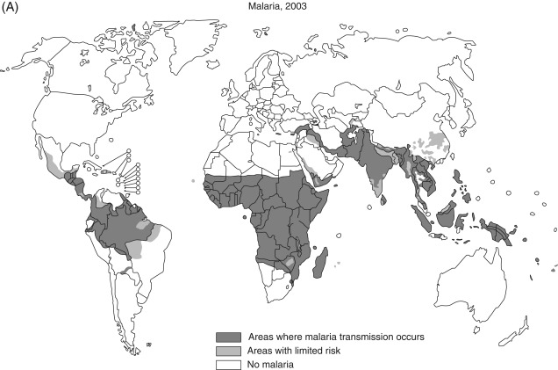
Endemic
endemic (from Greek ἐν en "in, within" and δῆμος demos "people") in a population when that infection is constantly maintained at a baseline level in a geographic area (Wikipedia)
Regularly found among particular people or in a certain area.
https://www.sciencedirect.com/topics/medicine-and-dentistry/endemic-disease

Slide 3
Endemic diseases

Slide 4
Outbreaks & Epidemics defined: Not so easily
Outbreak is “a sudden rise in the incidence of a disease” and typically is confined to a localized area or a specific group of people.
Epidemic: from the Greek epi [on] plus demos [people]
  An epidemic is an outbreak of contagious disease that has become more severe and less localized.
  outbreak of disease that spreads quickly and affects many individuals at the same time

Slide 5
Even more baffling definitions
An outbreak is a sudden increase in occurrences of a disease in a particular time and place
  It may affect a small and localized group or impact upon thousands of people across an entire continent!!??
    Four linked cases of a rare infectious disease may be sufficient to constitute an outbreak.
      Outbreaks include epidemics which term is normally only used for infectious diseases, as well as diseases with an environmental origin, such as a water or foodborne disease (Wikipedia)

Slide 6
When is an epidemic an epidemic?
Identifying an epidemic, however, can be fraught with ambiguity
A common definition, proposed by Benenson (1980): “The occurrence in a community or region of a group of illnesses… of similar nature, clearly in excess of normal expectancy.”
“a marked rise in the frequency of a specific infectious disease in a community over a limited period, beyond the frequency considered normal for the population under investigation” (Sawchuk, 2010)

Slide 7
When is there an “excess of normal expectancy” of cases/deaths?
Epidemics can be quantitatively defined for some diseases, “in which an arbitrary threshold is selected above which the term ‘epidemic’ is applied”
e.g. identifying an influenza epidemic in 1996
  In the UK: epidemic was achieved when there were 400 flu cases per 100 000 in one week
  USA: epidemic was determined by pneumonia and influenza death rates as set out by the CDC and Prevention
  e.g. CDC create intensity thresholds for flu severity in 2017
  Context specific and must be situated within space, place and time (Green, Swartz, Mayshar et al., 2002)

Slide 8
Quantifying an epidemic
To define a specific epidemic, need information on the nature of the spread, number of cases, case-fatality and area affected (localized or widespread)

Slide 9
Lay perception vs. Epidemiologists’ definition
An infection that spreads rapidly and affects many people in a defined region at the same or particular time
Epidemiologists use the term “outbreak” instead of “epidemic”
  population may not recognize the nature of the situation and fail to take the necessary precautions to protect itself against the epidemic

Slide 10
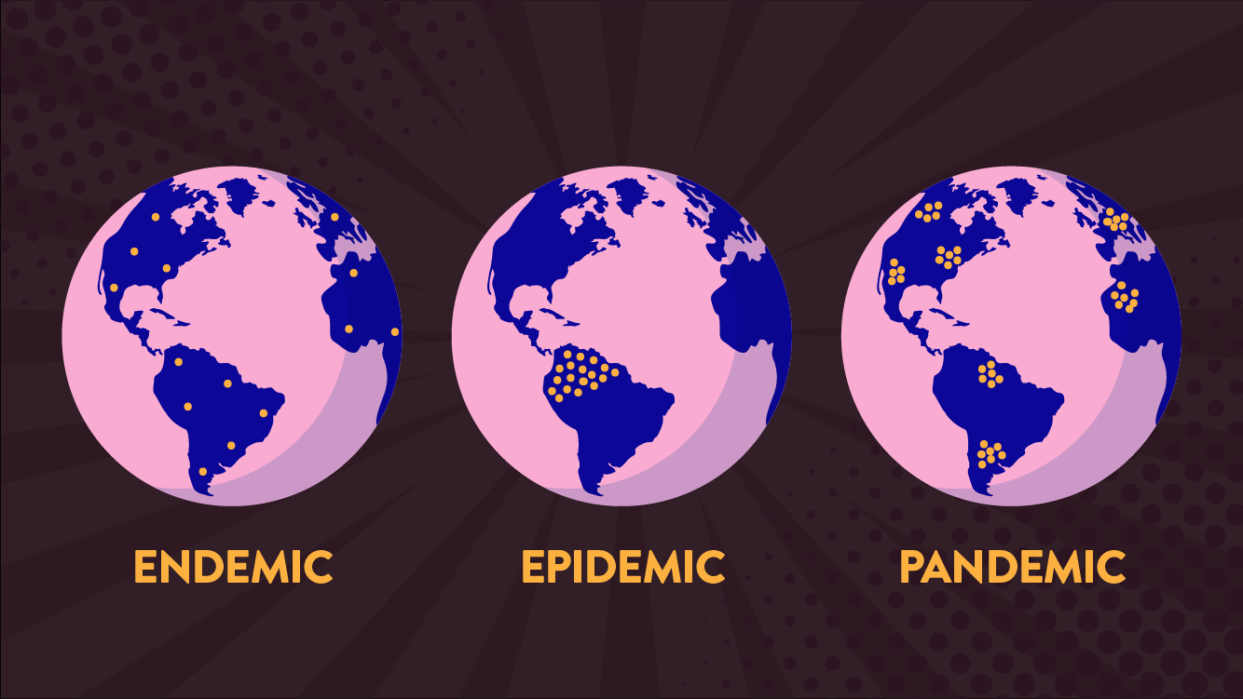
Pandemic
“All people” see: https://globalnews.ca/news/6644915/un-no-pandemic-coronavirus/
Disease is prevalent over a whole country or the world
Over a wide geographic area and affects an exceptionally high proportion of the population (Merriam-Webster, 2020)
Are near-global disease outbreaks when multiple countries across the world are infected.
An outbreak of an infectious disease that affects a large proportion of the population in multiple countries or worldwide
  Pandemics arise from epidemics

Slide 11
Archaeo-epidemiology
The method of studying historical epidemics of infectious disease, discerns the pattern in the waves of cases and deaths. These findings, in turn, help researchers of contemporary epidemics to address public health concerns with counter measures such as effective vaccinations
Great epidemics have appeal as “defining moments” or flashpoints, through inducing periods of terrible stress, by which aspects of a community’s social, medical and sanitary structure are brilliantly revealed

Slide 12
Harvesting Effect or short-term mortality displacement
occurs when there is a heightened, temporary, mortality rate in those with health complications because of underlying health problems, especially cardio-respiratory diseases and among the elderly or increased vulnerability associated with lower socioeconomic status (Dominici et al., 2003; Nobetti et al., 2000).

Slide 13
Harvesting - Traditional Examples
the aftermath of mortality experiences following outbreaks of respiratory disease among older individuals when preceded by heat waves, or episodes of air pollution and epidemics (Smith, 2003; Toulemon and Barbieri, 2008 )
Period of temporary enhanced survivorship can last weeks and months because the frail and weak have been removed

Slide 14
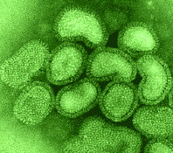
INFLUENZA
&
HARVESTING
1951
the dramatic
increase in the death rate among the aged,
followed
by an immediate decline in mortality in March.

Slide 15
How long is the harvesting period? How soon should rebound occur?
Limits of healthy period has not been established
Figure 4‑9. Male and Female Tuberculosis Mortality rates: Malta 1911-1949

Slide 16

Stress, Gender & Football
One study found that males are more vulnerable to increased mortality due to myocardial infarction and stroke on the day of their home team losing a football match.
Kirkup and Merrick (2003)

Slide 17
Consequences of epidemics
Can also elicit the deep-seated characters of community identity where the best and the worst human qualities are exposed, either through deeds of public and private charity or acts that ostracize minority groups or the powerless
  Power relationships invariably surface as the majority controls, silences and casts blame upon the powerless or minorities
  institutions implement costly and widespread reform to the sanitary and social infrastructure as well as bringing about changes in the very perception and treatment of the society’s underprivileged.

Slide 18
Why Study Epidemics
1. Serve as defining moments or flash points by which a community’s social, medical, and sanitary structure are illuminated
2. Can reveal deep-seated characteristics of community identity
  Best and worst features of a society
    Charity versus scapegoating

Slide 19
Why study epidemics?
3. Can provide unique opportunity to assess the actions of the government and/or the ruling class
4. Reveal the depth of privilege and poverty in a society and how that leads to health inequalities during an outbreak
5. Prepare for future outbreaks
6. There is inherent scientific value of the study of a disease itself
7. the disease can lead to change
  Biological/genetic
  Sanitary reform

Slide 20
Understanding unique phenomena in relation to general processes
As in populations, no two forests are the same, yet they share important features and processes in common relevant to understanding their genesis, longevity and degradation or decline

Slide 21
Some Generalizations about Epidemics
Based on part on the work of Fox, D.M. (1989) The History of Responses to Epidemic Disease in the U.S. in the 18th century. The Mount Sinai Journal of Medicine 56: 223-229
Question? Are these principles both timeless and placeless?
  Some historians would disagree
  Recall that these are only ‘generalizations’

Slide 22
1. At the beginning of an epidemic, many people will underestimate the severity of the problem
2. Considerable fear and anxiety will accompany the perception that the epidemic will gain strength over time

Slide 23
3. Extraordinary preventive or therapeutic measures
  Practices not currently part of common disease control measures; if ineffective move to “extraordinary measures”
    Medications, prayers, sacrifices, ceremonies (disinfect times or village, or destroy contaminated items), quarantine and isolation
      Quarantine:
        quarantena, meaning "forty days", used in the 14th–15th-centuries Venetian language and designating the period that all ships were required to be isolated before passengers and crew could go ashore during the Black Death plague epidemic
        a state, period, or place of isolation in which people or animals that have arrived from elsewhere or been exposed to infectious or contagious disease are placed.
        impose isolation on (a person, animal, or place)
      Entire villages are “cordon sanitaires”
      Lazarettos, sanitoria

Slide 24
Extraordinary preventive or therapeutic measures
Quarantine (other definitions)
        Separates and restricts the movement of people who were exposed to a contagious disease to see if they become sick.
        The separation of a group of people from a population and the restriction of their movement to prevent the introduction and spread of a disease.
        COVID quarantine in Canada: Quarantine (self-isolate) means that, for 14 days you need to:
          stay at home and monitor yourself for symptoms, even just one mild symptom
          avoid contact with other people to help prevent transmission of the virus prior to developing symptoms or at the earliest stage of illness
          do your part to prevent the spread of disease by practicing physical distancing in your home

Slide 25
Isolation: separates sick people with a quarantinable communicable disease from people who are not sick

Slide 26
4. In most epidemics, there will be a shortage of physicians and nurses to treat the sick
5. Efforts to quarantine and isolate are usually ineffective in limiting the spread of the disease

Slide 27
6. Initial responses to fear and anxiety will include:
  Flight or migration away from the epidemic area
  Denial
  Scapegoating of alleged carriers of the disease
    Individuals, groups, or classes of people
      Usually foreigners
    But can also blame authorities (religious or government)

Slide 28

The scapegoat
A goat sent into the wilderness after the Jewish chief priest had symbolically laid the sins of the people upon it (Lev. 16).
A person or group made to bear the blame for others or to suffer in their place.
(Hunt, 1854)

Slide 29
7a. Macro-Economics – There will be a Decrease in gross domestic product GDP.
The GDP of a country is defined as the total market value of all final goods and services produced within a country in a given period of time (usually a calendar year).
    Reduces capital formation
    Weakens the tax base
    Loss of human capital

Slide 30
    Greater impact on smaller companies with fewer resources at their disposal
    Stagnation in business - depression in spending by consumers
    Loss of productivity
    Replacement costs and retraining of employees
    Costs of absence of workers
    Health insurance or related benefits
    Increase in employee stress

Slide 31
7b. Micro-Economics: Cost to individuals & households
  Depletes lifetime savings and assets
  Increasing debt
  for the poor increased likelihood of entering or remaining in poverty trap
  Diverts monies from essential necessities such as food and accommodation
  Young are diverted from their education and sent to assist in acquiring household financial needs

Slide 32
7c. Cost - Medical System
Increased cost in hospital expenditures
  Increased staff
  Medicines and related materials
  Isolating patients
Printing and disseminating literature/information to the public
Implementation of Quarantine & Policing Measures
Disinfection of epidemic areas – from household to institutions

Slide 33
8. Impact on Family Structure
Breakdown of the Family Unit through loss of Husband/Wife
Cost of Funeral
Orphans
  Cost of caring for those orphaned
  Lack of care and education
Loss of Religious Faith
  Increase in Fatalism

Slide 34
9. Social Epidemiology
Not all epidemics are homogenous in their impact
  Why?
Not all people are equally susceptible/resistant during an epidemic
  Why?

Slide 35
Next week
Quantifying diseases
1918 influenza and other pandemic influenzas

