Slide 1
ANTH 298: Pandemics past & present
Disease Transmission, The Epidemiological Triad & The Chain of Infection

Slide 2
Non-Infectious Diseases (non-communicable)
These are diseases where no microbial agent is required and are intrinsic, arising from within the body (genetic) and/or environment
Cardiovascular disease
Diabetes
Cancer
Hypertension

Slide 3
Infectious Diseases (Communicable diseases)
These are diseases that are caused by a microbial agent
Examples:
Tuberculosis- mycobacterium tuberculosis
Measles- paramyxovirus
STDs- bacterial, viral infections
Cholera- vibrio cholerae
Influenza- virus, ie. H1N1

Slide 4
Classes of Infectious Disease
Infectious diseases are broadly classified into the following classes:
Disease Class Example
Enteric diseases | salmonella
Respiratory diseases | TB
Vaccine-preventable diseases | measles
Sexually transmitted diseases | Chlamydia
Bloodborne diseases | hepatitis B
Vectorborne diseases | Lyme disease
Zoonotic diseases | rabies
Notes:
Note there are some overlaps between bloodborne and STD diseases. (e.g. HIV can be sexually transmitted as well as transmitted via bloodborne means through contact with contaminated blood). HIV is a vaccine preventable disease

Slide 5
Reservoirs of Infectious Diseases
Reservoir: the site in which the infectious agent survives, grows, and reproduces
A reservoir can be living and non-living things
Some examples:
Humans (e.g. rubella)
Animals (e.g. primates, rodents)
Insects (e.g. mosquitoes and malaria)
Water (e.g. cholera)
Food items (e.g. E. coli in lettuce, salmonella in peanuts!)
Soil (e.g. tetanus)
Notes:
Reservoir: host population for an agent, where the agent naturally resides and reproduces

Slide 6
Transmission of Infectious Diseases
Transmission: the means by which an individual acquires an infectious disease
Either direct or indirect transmission
Direct Transmission
Direct contact- direct skin contact from person to person
Airborne/droplet- agent travels short-distance through air
Injection of drugs
Blood borne- direct blood-to-blood contact or transfusion
Sexual- through oral, anal, or vaginal
Vertical- mother to child during pregnancy or from breastfeeding
https://apps.who.int/iris/bitstream/handle/10665/43541/9241547073_eng.pdf?sequence=1

Slide 7
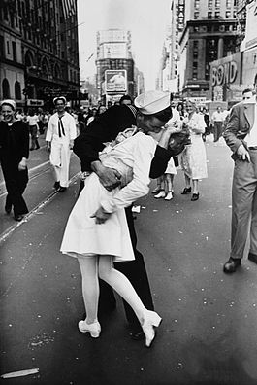
Unconditional Surrender
It is like a giant cartoon image drafted by a computer emulating a famous photograph. It's not the creation of an artist. It's an artist copying a famous image

Slide 8
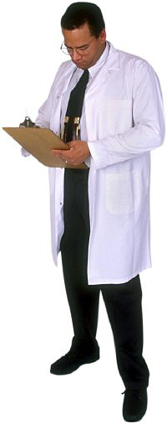
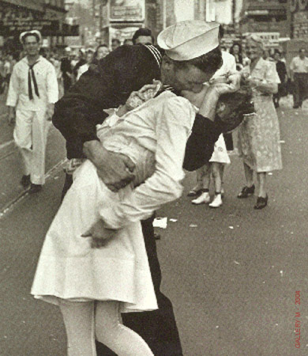
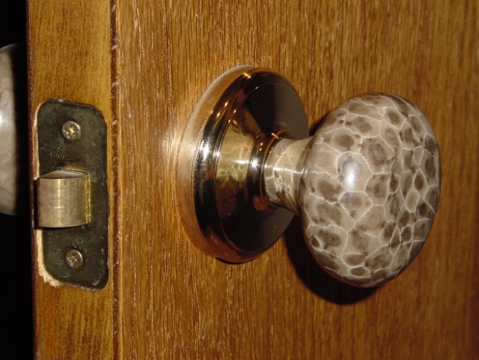
Contact
Direct transmission
Indirect transmission: via fomites:
inanimate objects which can be contaminated by an infected person (a ‘chance’ phenomenon)

Slide 9
Direct transmission: Droplet (Airborne)
Droplets, sneezing, or coughing:
Esp. relevant for respiratory diseases
Includes coughs, sneezes, spit
No further than 1-meter distance from source: proximity important

Slide 10
Airborne vs. Droplet transmission definitions
Basic epidemiology (WHO) doesn’t distinguish between the two terms
Shiu et al., states that fine respiratory droplets, is “sometimes also referred to as aerosol or airborne transmission,”
However WHO modes of transmission of COVID site states that:
Droplet as occurring within 1 m (and presumably 5-10 micrometres (droplet particles)

Slide 11
Indirect Transmission: Vechicles
Vehicles: contaminated objects or elements of the environment
Common vehicle: contaminated food, water and air
Fomite: contact with infectious item (e.g. doorknob)
Parenteral injections
The nature of vehicle can have important implications for scope of transmission – e.g., contaminated food or water source may reach large number of people

Slide 12
Indirect transmission: Airborne
Air-borne
Spread by droplet nuclei (1-4 micrometers) – either as an aerosol or on a dust particle
Travels over 1 meter
With respect to COVID, airborne transmission seem to be debatable
It is possible to transmit the disease through “aerosol generating procedures,” greater or less than a meter???
Some evidence that “strong airflow from the air conditioner could have propagated droplets,” across three tables in a restaurant in China
Both within and over 1 meter
Notes:
Although certain procedure like endotracheal intubation, bronchoscopy, open suctioning, administration of nebulized treatment, manual ventilation before intubation, turning the patient to the prone position, disconnecting the patient from the ventilator, non-invasive positive-pressure ventilation, tracheostomy, and cardiopulmonary resuscitation

Slide 13
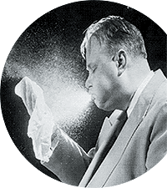
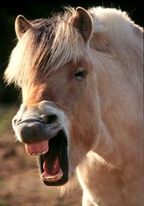
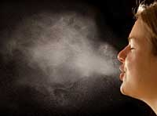
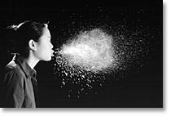
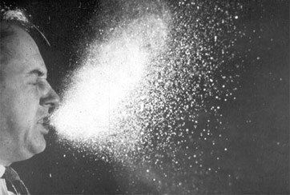

Slide 14
Mucous / Moisture droplets – the spray associated with a sneeze
Droplets are about at least 10 micrometers in size
Initial travelling time - 100 meters per second (200 miles per hour; 322 km per hour)

Slide 15
How far can a sneeze travel?
https://slate.com/human-interest/2014/04/mit-sneeze-study-new-research-shows-sneezes-can-travel-up-to-200-feet.html

Slide 16
Types of sneezes?
https://www.thestar.com/news/insight/2015/05/22/sneeze-politics-sorting-out-fact-from-sinus-fiction.html

Slide 17
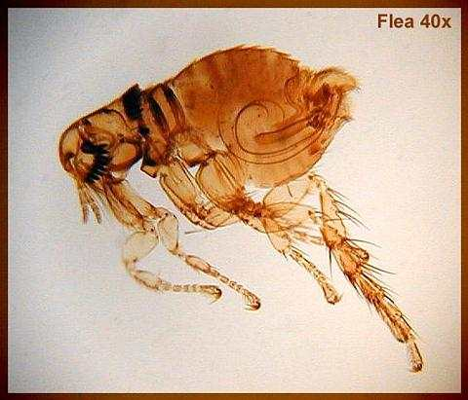
Indirect transmission: Vector
Vector-borne
Living transmitters of infection
Can include arthropods (e.g., mosquito) or vertebrates (e.g., bat)
Vectors may be involved in:
Internal: biological or harborage transmission
mechanical transmission (external)
Notes:
Harborage is when the disease is not altered in the vector (plague bacillus), whereas biological it is altered (malaria protozoa)

Slide 18
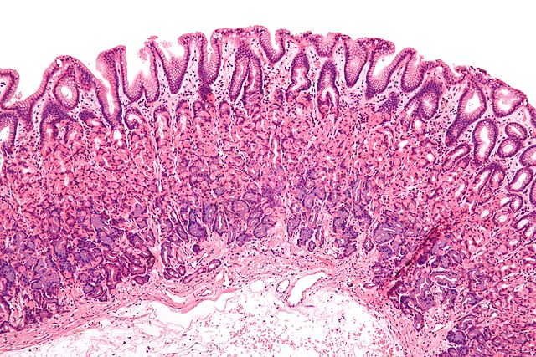
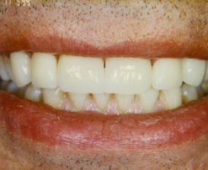
The Body’s First Lines of Defense
https://biologydictionary.net/mucous-membrane/
https://jamanetwork.com/journals/jamadermatology/fullarticle/409132
Mouth and Nose
mucous membrane lining mouth and nose
hairlike projections (cilia)
mucous and saliva contain enzymes

Slide 19
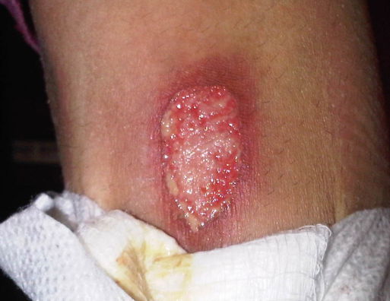
Portals of Entry
Mouth –Inhalation or Ingestion
Nose or ears
Penetration of the skin
Injuries
Insect/animal bites
Needle puncture
Person to person through direct contact

Slide 20
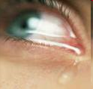
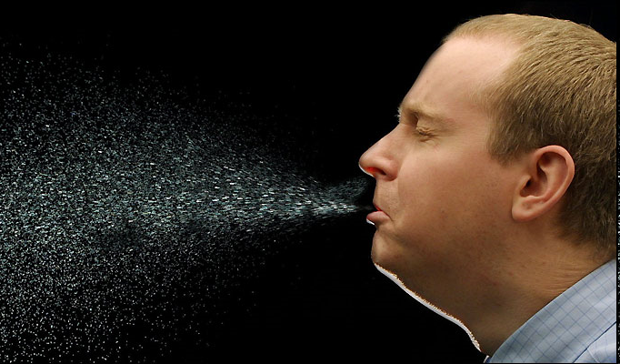
Portals of Exit
Mouth (vomit, sputum, saliva)
Eyes (tears)
Body surfaces (skin, crusts)
Punctures (break in the skin)
Urogenital (urine, semen)
Anus (feces)

Slide 21
Acute Community Infections
Any infectious disease that is spread in the community
Common example is the annual flu season
Contrast with:
Institutional-based infections (e.g. long-term care home, hospitals)
Facility-based infections (e.g. schools)
Notes:
Nosocomial infections

Slide 22
Elements of Host resistance
The ability to be resistant to a disease depends on:
Agent type
Biological, chemical, physical or nutritional
Host characteristics
Age, sex, religion, occupation, genes, immune status, previous exposure to diseases
Environment
Temperature, water, crowding, nieghbourhood pollution, noise
(Social and physical)
vector
The epidemiological triad!

Slide 23
Host(s)
Exposure, Susceptibility, Immune Response
previous experience with the disease
state of the host body (nutrition, other diseases)
Age, gender, sex
ability to leave (avoid)
living and working conditions

Slide 24
Agent (Disease-causing microbe)
Ability to survive outside a host
Ability to produce toxins (reduce host immunity, RBCs & iron)
Susceptibility/resistance to antibiotics

Slide 25
Environment
Physical (geology, climate) environment
Cultural, Social, Political factors Socio-economic factors (e.g., poverty)

Slide 26
Chain of Infection
Infectious Agent
Susceptible Host
Reservoir
Portal of Entry
Portal of Exit
Transmission Mode
Diagram adapted from http://faculty.ccc.edu/tr-infectioncontrol/chain.htm#

